Slide 1
Adolescent HIV Care and Treatment
Module 11:
Family Planning and PMTCT Services for Adolescents

Slide 2
Module 11 Learning Objectives
After completing this module, participants will be able to:
List the risks of adolescent pregnancy
Discuss childbearing choices and safe childbearing with adolescent clients
Understand the contraceptive issues and challenges faced by ALHIV
Counsel adolescent clients on prevention of mother-to-child transmission of HIV (PMTCT)

Slide 3
Session 11.1
Family Planning Counseling for ALHIV

Slide 4
Session 11.1 Objectives
After completing this session, participants will be able to:
List the risks of adolescent pregnancy
Discuss childbearing choices and safe childbearing with adolescent clients
Understand the contraceptive issues and challenges faced by ALHIV

Slide 5
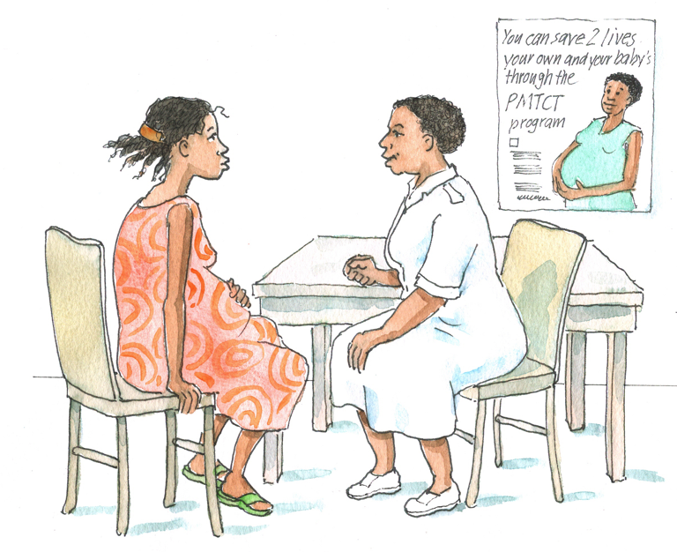
Brainstorming
What are some of the risks of adolescent pregnancy?
Think about the health risks and the potential psychological, social, and economic consequences for both adolescent boys and girls.

Slide 6
Risks of Adolescent Pregnancy
Health Risks:
Pregnancy complications (obstructed delivery, prolonged labor)
Pre-eclampsia
Anemia
Complications associated with unsafe abortion
Premature birth and low birth weight
Spontaneous abortion and stillbirth, especially among adolescents < 15 years of age
Mother-to-child transmission

Slide 7
Risks of Adolescent Pregnancy (Continued)
Psychological, social, and economic risks:
Stigma from family, friends, community members, and HCWs, causing emotional distress and barriers to needed care
Pregnancy often means the end of formal education
Changes in academic aspirations and career choice (for men and women)
Changes in future marriage prospects (particularly for young women)
In order to support their children, some young mothers resort to low-paying and risky jobs (such as prostitution) or early marriage

Slide 8
Risks of Adolescent Pregnancy (Continued)
Early marriages that result from an unplanned pregnancy are frequently unhappy and unstable
Some men refuse to take responsibility, which can contribute to hardship for the mother and child
If parents are unprepared to raise the child, child-rearing problems like abuse or neglect (in extreme cases)
Fathers of children born to adolescent mothers are more likely to earn less, get less education, and experience depression
Compared to older fathers, adolescent fathers are:
Less likely to have plans for a future job
More likely to have anxiety
More likely to be homeless or living in very unstable households

Slide 9
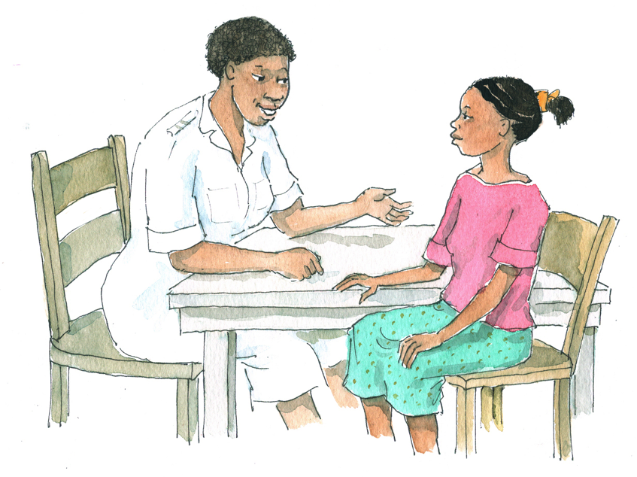
Brainstorming
How can we, as health workers, communicate the risks of adolescent pregnancy to our clients in a non-judgmental and supportive way that respects their rights?

Slide 10
Counseling Adolescents on the Safest Times to Have Children in the Future
Adolescent clients may have concerns about having children in the future.
Advise clients that it is safest to:
Wait until adulthood to have children, due to the risks of adolescent pregnancy
Get pregnant when the woman:
Has a CD4 count above 500
Is healthy — she does not have any opportunistic infections (including TB) or advanced AIDS
Is taking and adhering to her ART regimen, and her ART regimen is not EFV-based

Slide 11
Counseling Adolescents on the Safest Times to Have Children in the Future (Continued)
If her partner is HIV-infected, to get pregnant when he also:
Has a CD4 count above 500
Is healthy —he does not have any opportunistic infections (including TB) or advanced AIDS
Is taking and adhering to his ART regimen
If already a mother, to wait until the child is at least 2 years old before getting pregnant again
It is important for ALHIV to know the facts about pregnancy and PMTCT before they become pregnant.

Slide 12
EFV and Pregnancy
Because of the theoretical risk of EFV causing neural tube defects:
Women at risk of conception or women for whom contraception is not ensured should be given an ART regimen that does not include EFV.
EFV should not be initiated in the first trimester of pregnancy, but it may be initiated in the second or third trimester.
If a woman on an ART regimen containing EFV is diagnosed as pregnant before 28 days of gestation, EFV should be stopped and substituted with NVP or a PI. If a woman is diagnosed as pregnant after 28 days of gestation, EFV should be continued.
There is no indication for termination of pregnancy in women exposed to EFV in the first trimester of pregnancy.

Slide 13
Discussion Questions
Where you work, are adolescents provided with counseling on family planning and contraception? Why or why not?
Remember, it is important to provide "one-stop shopping" for adolescent clients. This includes contraceptive counseling and methods.

Slide 14
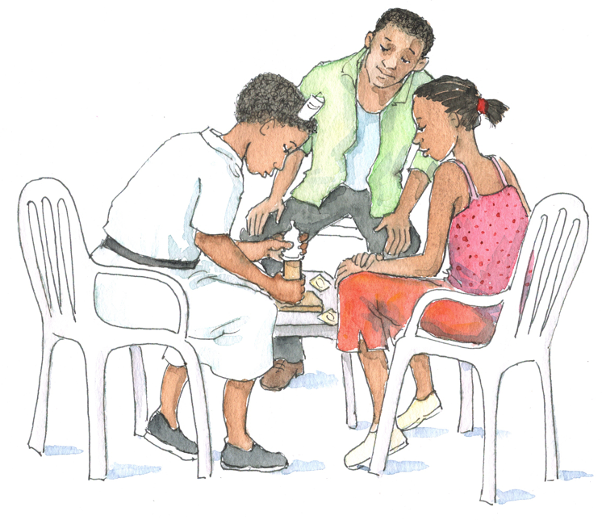
Discussion Questions
What do you ask clients to initiate the discussion about contraception?
What do you ask next?
How often do you screen for pregnancy status and family planning intentions?

Slide 15
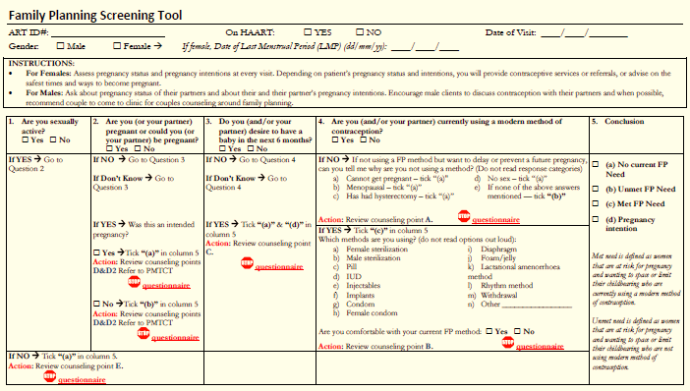
Common Contraceptive Issues for Adolescents
Key screening questions for family planning counseling sessions are included in Appendix 11A: Family Planning Screening Questions and Counseling Points.

Slide 16
Common Contraceptive Issues for Adolescents (Continued)
Adolescents have special needs when choosing a contraceptive method (consider social, behavioral, and lifestyle issues).
Adolescents are less tolerant of side effects and have high family planning discontinuation rates.
Expanding the number of methods available and providing education and counseling can increase contraceptive acceptance and use as well as satisfaction.
At a minimum, all adolescents should be counseled on correct condom use.
When possible, contraceptive methods should be provided to adolescents for free.

Slide 17
Additional Contraceptive Issues for ALHIV
Women living with HIV can safely use most forms of hormonal contraceptives.
However, ARVs may affect the efficacy of some hormonal methods, although the clinical significance of these interactions is unclear
Health workers prescribing hormonal contraceptives should:
Counsel ALHIV on ART about possible interactions
Stress the importance of adherence to ARVs and the hormonal method
Recommend dual method use – a hormonal method AND condoms
Provide women taking rifampicin for TB with a back-up method of contraception
See Appendix 11B: Family Planning Considerations for People Living with HIV.
Always follow your national family planning guidelines.

Slide 18
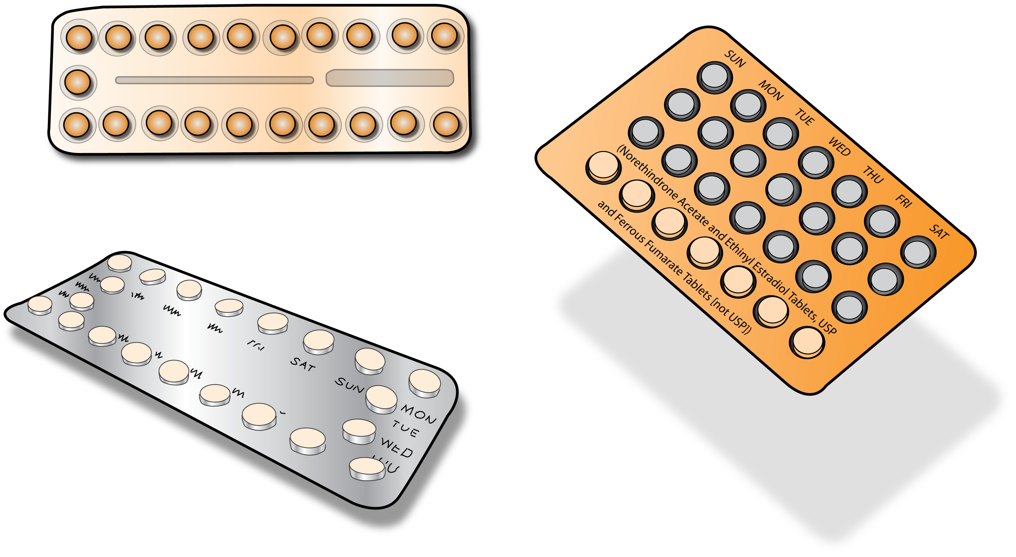
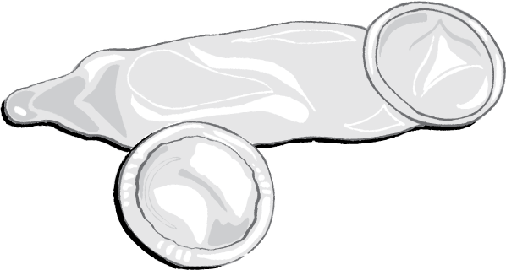
Discussion Questions
In general, what contraceptive methods are available to adolescent clients?

Slide 19
Contraceptive Options for ALHIV
See Table 11.1: Summary of contraceptive options for ALHIV and Appendix 11C: Survey of Family Planning Methods for Adolescents .
Good options for ALHIV:
Male and female condoms
Combined oral contraceptive pills (COCs) and progestin-only oral contraceptive pills (POPs) — pills taken daily
Injectables — “shot” given every 2–3 months
Emergency contraceptive pills (ECP) — 2 doses of pills taken within 120 hours after unprotected sex
Hormonal implants — small rods inserted under skin, lasts 3–7 years
Abortion (where legal and safe)

Slide 20
Contraceptive Options for ALHIV (Continued)
Other options – less recommended for ALHIV:
Intra-uterine devices (IUDs) — device inserted into uterus, lasts up to 12 years
Male and female sterilization — surgery
Lactational amenorrhea method (LAM)
Fertility awareness methods

Slide 21
Discussion Questions
What are the main advantages of this option?
What are the main disadvantages?
Does this option bring up any concerns for ALHIV on ART (e.g., drug interactions)?
Given the advantages and disadvantages, what do you think about this option for ALHIV?
Remember that most methods are safe and effective for ALHIV as long as they are provided with proper counseling and follow up.

Slide 22
Contraceptive Side Effects
Adolescents may experience side effects from contraceptive methods (e.g., weight gain, spotting, menstrual changes), which can be uncomfortable, annoying, or worrisome.
Side effects are the major reason that adolescent clients stop using contraceptive methods.
Remember:
Treat all complaints with patience and seriousness.
Offer opportunity to discuss their concerns.
Reassure clients that side effects are manageable and reversible.
Help differentiate between normal vs. serious side effects.
Offer information and advice on how to prevent/manage side effects.
Always provide follow-up counseling.

Slide 23
Questions or comments on this session?

Slide 24
Session 11.2
PMTCT Counseling for ALHIV

Slide 25
Session 11.2 Objective
After completing this session, participants will be able to:
Counsel adolescent clients on prevention of mother-to-child transmission of HIV (PMTCT)

Slide 26
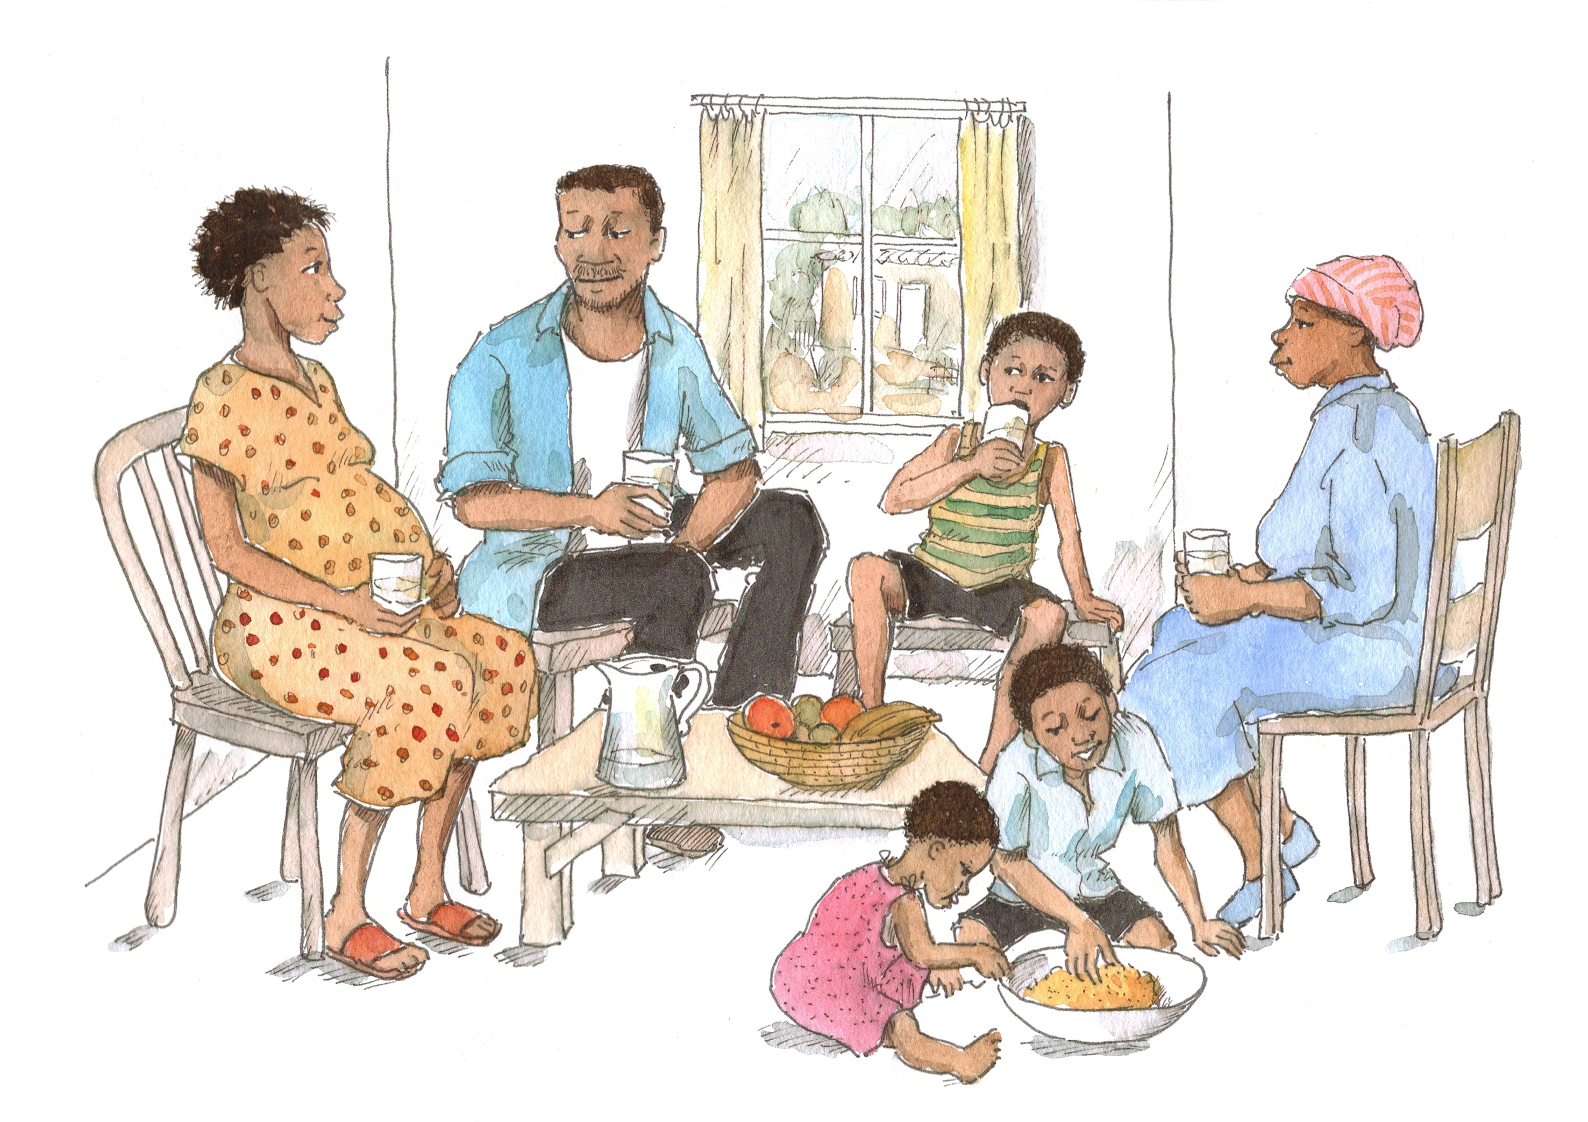
PMTCT Services for Adolescents
Who has been trained in PMTCT (raise your hand)?
PMTCT counseling and services are an important part of adolescent HIV care and treatment services.
Remember to always follow national PMTCT guidelines when providing services to pregnant ALHIV, their partners, and their family members.
26

Slide 27
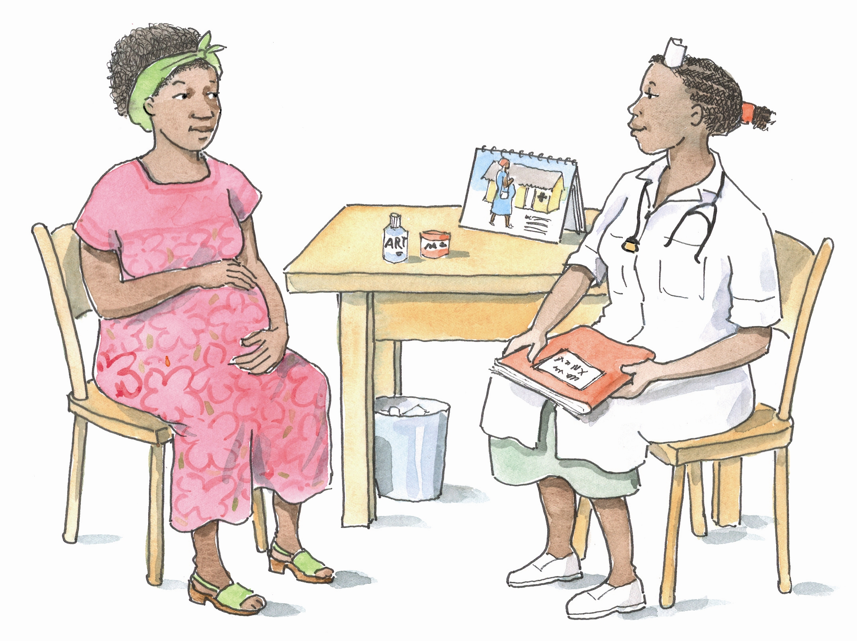
Key PMTCT Concepts
See Table 11.2.
Key Concept 1 - Keep mothers healthy
The healthier the mother, the less likely it is that her baby will acquire HIV

Slide 28
Key PMTCT Concepts (Continued)
Key Concept 2 – Reduce risk at every stage
MTCT risk depends on timing:
During pregnancy, labor, and delivery, about 20-25 out of every 100 babies will get HIV in the absence of PMTCT services, including ARVs.
During breastfeeding, about 12-15 out of every 100 babies will get HIV in the absence of PMTCT services, including ARVs.
Breastfeeding risk depends on:
How the baby is fed — breastfeeding exclusively during the first 6 months of life can lower the risk of HIV transmission
How long the baby is breastfed
If the mother or infant is on ARVs
It is important to help mothers reduce the risk of transmission at every stage!
28

Slide 29
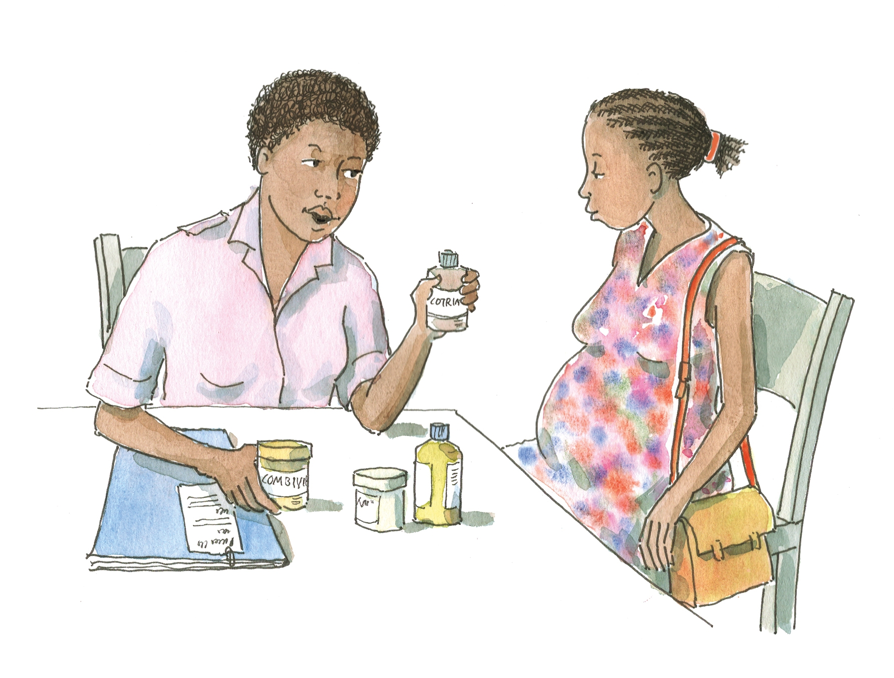
Key PMTCT Concepts (Continued)
Key Concept 3 – All mothers need ARVs
All pregnant women living with HIV need to take ARVs.
If the mother has a CD4 cell count at or below 350: start lifelong ART as soon as possible.
If the mother has a CD4 cell count above 350: start ARV prophylaxis at 14 weeks gestation or as soon as feasible thereafter.
Follow your national PMTCT guidelines.
29

Slide 30
Key PMTCT Concepts (Continued)
Key Concept 4 – All babies of HIV-infected mothers need ARVs and CTX
All babies need to take ARV prophylaxis at the time of birth and for the first 4–6 weeks of life to prevent them from becoming HIV-infected. Follow your national PMTCT guidelines.
If the mother is on ARV prophylaxis and is breastfeeding, either she or her baby must take ARVs until one week after cessation of breastfeeding.
If the mother is on ARV prophylaxis and is formula feeding, her baby needs to take ARVs from birth to 4-6 weeks of age.
If the mother is on ART or triple ARV prophylaxis that will be continued postpartum, her baby needs to take ARVs from birth to 4-6 weeks of age.
Remember that either the mom or the baby needs to take ARVs for the entire duration of breastfeeding (until 1 week after breastfeeding ends).

Slide 31
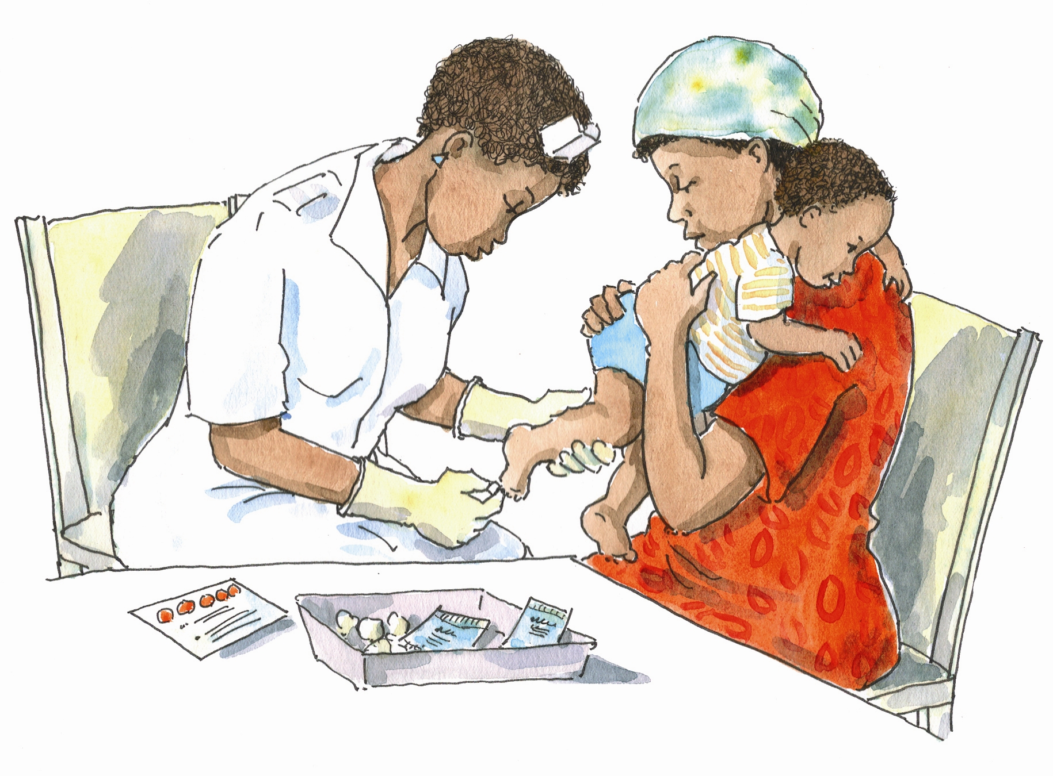
Key PMTCT Concepts (Continued)
Key Concept 4 – All babies of HIV-infected mothers need ARVs and CTX (Continued)
HIV-exposed babies need to have HIV virological testing (e.g. DNA PCR) at 4–6 weeks of age or as soon as possible thereafter
Babies who test HIV-positive and who are under the age of 12 months (or in some countries 24 months, follow your national guidelines) should begin ART as soon as possible
HIV-exposed babies need to take CTX starting at 4–6 weeks of age to prevent infections. They should continue CTX until it is certain they are NOT HIV-infected.

Slide 32
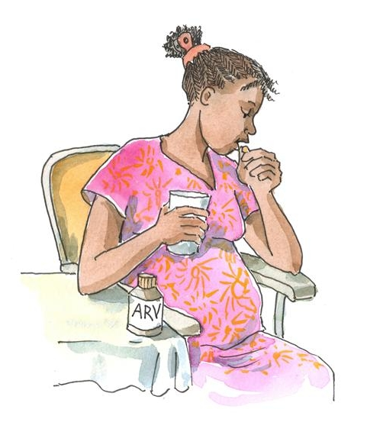
Brainstorming
What are some of the challenges adolescents might have with PMTCT?
32

Slide 33
Challenges Adolescents May Face with PMTCT
Difficulty adhering to ART or ARV prophylaxis
Difficulty giving the baby medicines every day
Challenges with safe infant feeding, especially exclusive breastfeeding
Fears and guilt about having a baby who is HIV-infected
Pregnant adolescents should be reassured that, with the possible exception of EFV, ARVs are safe to use during pregnancy. The benefits of using ARVs far outweigh the risks of not initiating ART.

Slide 34
Challenges Adolescents May Face with PMTCT (Continued)
Facing stigma for having HIV and becoming pregnant at a young age
Difficulty foreseeing the future adhering to lifelong HIV care
Lack of emotional and financial support
Financial instability and the possibility of dropping out of school
Inadvertent disclosure of HIV-status to others
Lack of access to youth-friendly PMTCT services

Slide 35
Exercise 1
Providing Family Planning and PMTCT Services to Adolescent Clients: Case studies, role play, and large group discussion

Slide 36
Exercise 1: Case Study 1
P___ is a 19-year-old young man who comes to the ART clinic regularly. You learn from one of the Adolescent Peer Educators at your clinic that P___ has been bragging that he has been with "about 10 women" but never uses condoms because they are “good girls” who don’t insist on using them. When you offer him some condoms at the end of his next appointment, he says he doesn’t need them. He says that he has a steady girlfriend now because he is feeling pressure from family to "get serious."
→ How do you proceed with P___?

Slide 37
Exercise 1: Case Study 2
K___ is a 17-year-old young woman living with HIV. She is on ART and is doing very well. She has a boyfriend who knows about her HIV-status and who is accepting of it. K___ used to take oral contraceptives, but stopped taking them recently because she said they made her feel nauseous and gain weight. Now K___ and her boyfriend usually use condoms, but they have had sex a few times without them. K___ and her boyfriend do not want children right now, but they talk about getting married and having children in the future, once she finishes school. K___ is getting a lot of pressure from her family to never have kids because of the risk that they would be HIV-infected.
→ How would you proceed with K___?

Slide 38
Exercise 1: Case Study 3
Z___ is a 21-year-old woman who has been living with HIV since she was 16. She has been in a stable relationship with R___ since she was 18. R___ is also living with HIV. Although Z___ attends the adult ART clinic now, she comes back every now and again to visit you, the health worker, at the adolescent clinic. Today you get the feeling that there’s something she wants to talk about so you invite her into the counseling room. You ask her how she’s doing and then ask her about R___. After some small talk, she finally tells you that she and R___ have decided that they would like to have a baby. After asking her some more questions, you realize that she is very serious about this and you agree that this was a mature, well-thought through decision that the two of them made together.
→ How would you proceed with Z___?

Slide 39
Exercise 1: Case Study 4
E___ is 19 years old and was perinatally infected with HIV. She has been adherent to ARVs for many years. She has come to the clinic today for a checkup and, during the visit, she tells you that she thinks she is pregnant. She is happy to be pregnant, but is afraid that her baby will become HIV-infected. She is also worried about how her ARVs might be affecting her unborn child and tells you that her boyfriend — who is not infected with HIV — told her to stop taking them so they wouldn’t hurt the baby.
→ How would you proceed with E___? (Assume her pregnancy test is positive.)

Slide 40
Exercise 1: Large Group Discussion Questions for Each Case Study
What were the main issues for this client? What do you think the client was thinking and feeling when he or she was with the health worker?
How did the health worker address the client’s needs? What kinds of assessments and screening did he or she conduct?
What kind of education and counseling did the health worker offer the client? What was good about this and what do you think could have been done better or differently?
What age-appropriate communication techniques/approaches did the health worker use to build trust and make the client feel comfortable? What was done well and what do you think could have been done better or differently?

Slide 41
Exercise 1: Debriefing
What did we learn?
Key points:
We all play an important role in providing ALHIV with information, counseling, and clinical services related to their sexual and reproductive health. This includes info and services related to safe childbearing, contraception, and PMTCT (and topics discussed in Module 10).
These issues are sensitive and sometimes embarrassing. Try to make adolescents feel comfortable and try to “normalize” SRH services as a standard part of comprehensive HIV care and treatment.
Use good communication techniques, ensure a youth-friendly environment, and project an open, non-judgmental attitude.

Slide 42
Questions or comments on this session?
42

Slide 43
Module 11: Key Points
Given the risks of adolescent pregnancy, health workers should counsel their young clients to delay childbearing, if possible, until they are adults and to use contraceptive methods if they are sexually active.
Health workers can provide adolescent clients with counseling on the safest times to become pregnant.
Good education and counseling both before and at the time a contraceptive method is selected can help adolescents make informed, voluntary decisions that they are more likely to adhere to in the long term.

Slide 44
Module 11: Key Points (Continued)
The following contraceptive methods can be good options for ALHIV: condoms, COCs/POPs, injectables, hormonal implants, and IUDs.
Counsel all clients on correct condom use, whether condoms are their primary contraceptive choice or whether they will be used for dual protection.
Ensure that all adolescent clients know about emergency contraceptive pills, including where they can get them.
Provide counseling on PMTCT and refer all pregnant ALHIV to the ANC clinic for PMTCT services.

Slide 45
Module 11: Key Points (Continued)
Pregnant adolescents should be reassured that, with the possible exception of EFV, ARVs are safe to use during pregnancy.
The aim of PMTCT services is to reduce the risk that a pregnant woman will transmit HIV to her baby during pregnancy, labor, delivery, or breastfeeding.
PMTCT services include care, treatment, and support for mothers with HIV, including ARVs for the mother; safer infant feeding information, counseling, and support; ARVs for the infant; and infant testing.

