Slide 1
Adolescent HIV Care and Treatment
Module 12:
Community Linkages and Adolescent Involvement
Notes:
1

Slide 2
Module 12 Learning Objectives
After completing this module, participants will be able to:
Discuss common challenges to creating strong facility-community linkages in support of ALHIV and their caregivers, and strategies to overcome these challenges
Describe community-based support services that ALHIV and their caregivers may need
Create a community resource directory for adolescent clients and caregivers

Slide 3
Module 12 Learning Objectives (Continued)
Describe the rationale behind meaningful adolescent involvement and describe effective strategies of involving adolescents in service delivery
Understand the key components of implementing a successful Adolescent Peer Education program

Slide 4
Session 12.1
The Importance of Facility-Community Linkages

Slide 5
Session 12.1 Objectives
After completing this session, participants will be able to:
Discuss common challenges to creating strong facility-community linkages in support of ALHIV and their caregivers, and strategies to overcome these challenges
Describe community-based support services that ALHIV and their caregivers may need

Slide 6
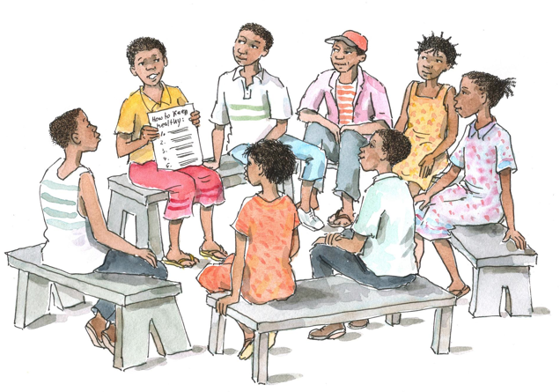
Discussion Questions
What are some of the challenges to having good facility-community linkages?
What are some of the specific ways we can improve facility-community linkages for ALHIV and their caregivers?

Slide 7
Remember:
Linkages to community resources and support are important to help ALHIV and their caregivers get access to the services and support they need.
There are community-based services available for ALHIV in most places, but groups often do not know about each other or do not know how they can work together.
Without collaboration between health facilities and community-based organizations, health workers are handicapped in their ability to refer clients and their families to the community-based organizations that can assist them.
Notes:
7
7

Slide 8
Challenges to Establishing Facility-Community Linkages
HCWs may not be aware of community-based services or there may be no mechanism to exchange information or to formalize two-way referrals.
Community organizations/leaders may not be aware of adolescent HIV services at the health facility.
Teachers may not be familiar with HIV or the needs of ALHIV.
Community organizations/leaders may not trust facility-based services or may prefer traditional medicine.

Slide 9
Challenges to Establishing Facility-Community Linkages (Continued)
There may not be any community services specifically for ALHIV.
A health facility may get a reputation for treating adolescents poorly.
Service delivery may be fragmented, uncoordinated, and/or not youth-friendly.
There may be high transportation costs between the community and the health facility.
Notes:
9
9

Slide 10
Strategies to Improve Facility-Community Linkages
Learn what community organizations and services are available:
Visit these organizations to find out what services they offer
Set up formal or informal “two-way” referral systems
Facilitate regular meetings with stakeholders to:
Share information about the needs of ALHIV
Discuss available services
Discuss how to facilitate interagency linkages and referrals
Meet with community leaders to talk with them about ALHIV and the importance HIV care and treatment services.
Notes:
10
10

Slide 11
Strategies to Improve Facility-Community Linkages (Continued)
Participate in community meetings to discuss HIV, ALHIV, and HIV care and treatment.
Train/orient community-based Peer Educators, youth group members, and community health workers to:
Identify and refer adolescents for HIV testing and care and treatment
Provide adherence and psychosocial support to ALHIV and caregivers
Follow up with clients who have missed appointments
Start support groups for adolescents.
Involve young community members openly living with HIV in strengthening facility-community linkages.
Notes:
11
11

Slide 12
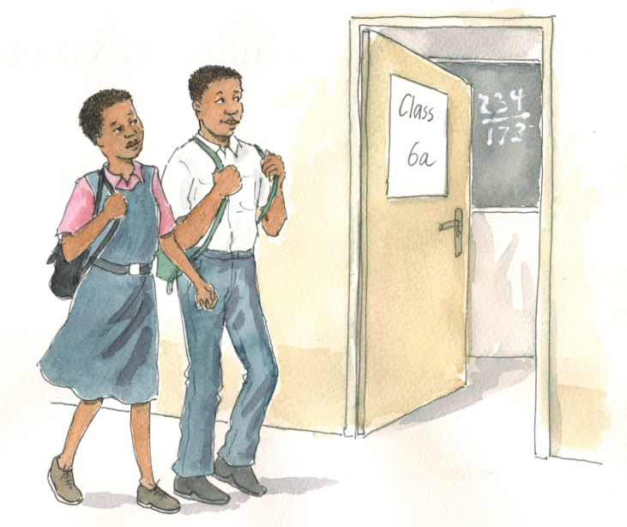
Brainstorming
What are the most common support needs of ALHIV that can be provided in the community or at home?
Then…
Of these, what are the 5 most important needs?

Slide 13
Discussion Questions
For each of the 5 most important needs:
Why is this type of community or home-based support important for ALHIV?
What specific organizations provide this type of support in your community? What have been the challenges and successes you have had linking with these organizations?
How are these organizations linked to the health facility?

Slide 14
Remember the Continuum of Care
Continuum of care
Remember: no single person or organization can provide all of the services and support ALHIV and their families need. We must work together to provide a continuum of ongoing care and support within the health facility, in the community, and at home.

Slide 15
Questions or comments on this session?

Slide 16
Session 12.2
Creating a Community Resource Directory

Slide 17
Session 12.2: Objective
After completing this session, participants will be able to:
Create a community resource directory for adolescent clients and caregivers

Slide 18
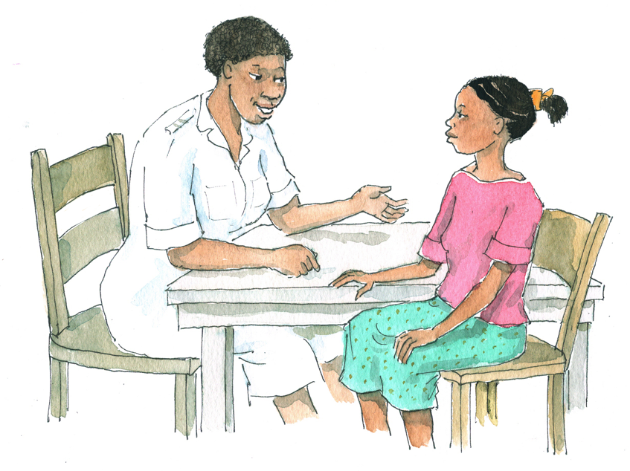
Discussion Questions
What are the informal and formal referral processes used to link clients with support services at your clinic and in the surrounding community (including forms used)?
What are the specific steps to make a referral from the health facility to a community organization? From a community organization to the health facility?
What is done to follow up the referral (to ensure that the client received the services to which he or she was referred)?

Slide 19
Creating a Community Resource Directory
Each facility should develop and regularly update a community resource directory to make it easier to refer clients.
Include days/times services are offered, fees, documentation required at the initial visit, address, phone number, contact person, etc.
Post copies in the clinic waiting room and make copies available in exam and counseling rooms.
Designate one person to be responsible for keeping up to date with any changes and adjusting the directory accordingly.
Each clinic should establish two-way referral systems to and from the organizations in the directory.
Work with youth to map available resources in the community for ALHIV and their families.

Slide 20
Exercise 1
Creating a Community Resource Directory: Small group work and large group discussion

Slide 21
Exercise 1: Small Group Work
See Appendix 12A: Community Resource Directory Template.
In your small group, brainstorm services available in the community for ALHIV and fill in the community resource directory.
Discuss these questions in your small group:
What is being done now to link clients with these groups and organizations?
What could be done to improve referral linkages with the groups and organizations listed in the directory?
Think about these services:
ALHIV support groups
Nutritional and food support
Home-based care and adherence support
Education and counseling
Social grants
Support accessing supplies
Condom distribution outlets
Support for child-headed households and OVC
Education and life skills
Job preparation and placement
Spiritual support
Income-generating programs
Legal support

Slide 22
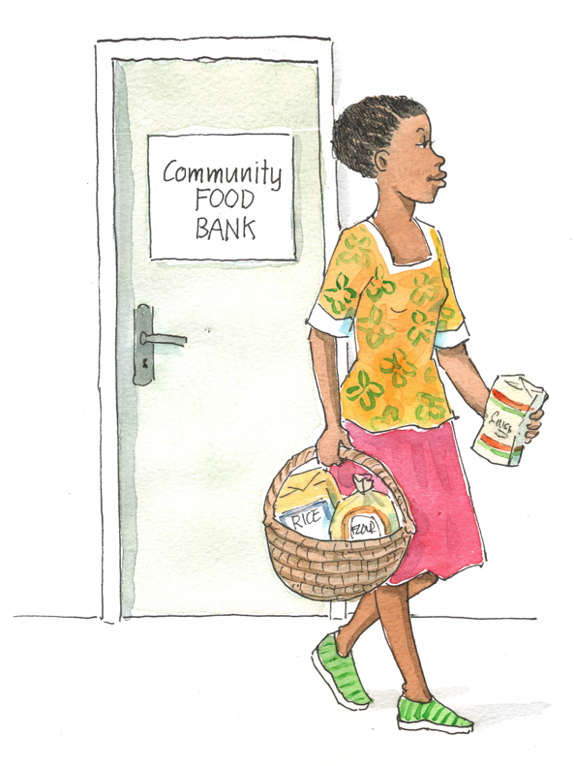
Exercise 1: Large Group Discussion
What are the next steps you will take to complete your community resource directory?
How will you use the directory in your clinic?
How will you keep the directory updated?

Slide 23
Exercise 1: Debriefing
What did we learn?
Key points:
To ensure good facility-community referrals, it is essential that we develop, maintain, and use an up-to-date community resource directory.
After the training, work with other members of your team and with community organizations to complete the directory.
It is important to keep the directory up-to-date. Adolescent Peer Educators and other youth should be involved in this process.

Slide 24
Questions or comments on this session?

Slide 25
Session 12.3
Adolescent Participation and Peer Education Programs

Slide 26
Session 12.3 Objectives
After completing this session, participants will be able to:
Describe the rationale behind meaningful adolescent involvement and describe effective strategies of involving adolescents in service delivery
Understand the key components of implementing a successful Adolescent Peer Education program

Slide 27
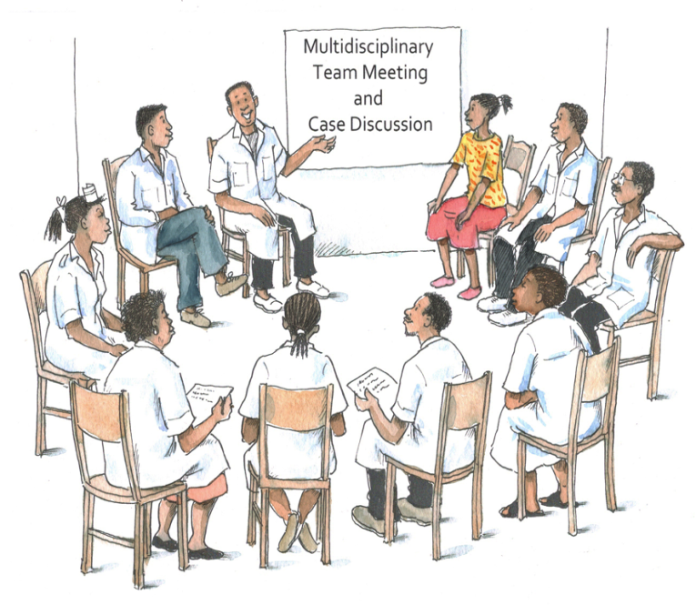
Discussion Questions
Why do you think it is important to involve ALHIV in clinical services?
What, if any, youth involvement do you have in your current program? What else could you initiate or what could you expand?
In what ways could Adolescent Peer Educators complement the work of the MDT and improve services?

Slide 28
Adolescent Involvement
Contributes powerfully to the HIV response by supporting people to draw on their own experiences to increase the effectiveness and appropriateness of services
Is critical to ensure that services are designed and implemented to meet client needs
Requires commitment from every member of the MDT

Slide 29
Adolescent Peer Educators
APE can complement the work of health workers and they play an important role in improving client adherence and service quality.
Adolescent peer education offers many benefits:
A safe environment
Improved retention in care
Improved adherence to treatment
Improved linkages
Increased positive living
Improved service quality
Increased community participation and advocacy
Job opportunities
Increased access to services
A closer sense of connection for adolescent clients

Slide 30
Discussion Questions
What is a “CAB” (client/consumer/community advisory board)?
What experience do you have with CABs?
Do you think it might be possible to recruit adolescents and their caregivers to function as adolescent HIV CAB members? If no, why not? If yes, what challenges might you expect?

Slide 31
Client/Consumer/Community Advisory Boards (CABs)
CABs are autonomous bodies that advise the clinic on service quality and gaps in care. They also make recommendations on how to improve service provision.
CABs:
Include 5–20 members, most or all of whom are clients or caregivers
Typically meet every other week at first and monthly once established
Have a direct line of communication with clinic management.
Are guided by a set of by-laws developed by members and approved by the clinic they advise

Slide 32
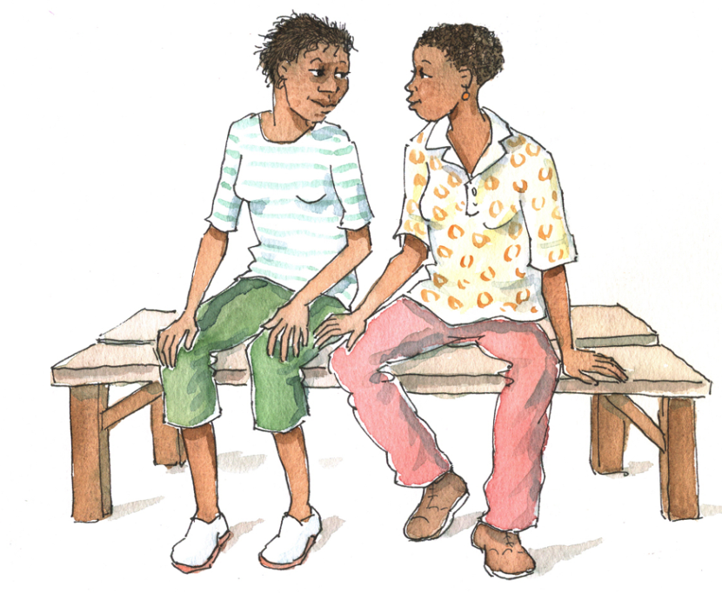
Discussion Questions
Have you ever seen youth involved in an organization in a way that was not productive to the organization? Is it possible to make mistakes when involving youth?
If so, what mistakes have you seen or could you imagine happening?

Slide 33
Avoid Tokenism
Adolescents should be recognized, integrated, and supported as the vital human resource they are.
Tokenism is not the same as partnership or meaningful involvement and participation.
Examples of tokenism include:
Having youth present but with no clear role, training, support, or supervision
Asking youth their opinions but not taking these opinions seriously
Assigning tasks to youth that adults do not want to do, like filing or cleaning
Notes:
33
33

Slide 34
Ensure Expectations are Appropriate
Keep expectations and assigned responsibilities and tasks realistic (e.g. an APE should not be expected to provide professional-level counseling)
Provide follow-up training and ongoing mentoring and supervision.
Make boundaries very clear to APE and CAB members, and enforce them in a transparent way. Make sure that the program has explicit rules and that APE are supervised and supported to adhere to them.

Slide 35
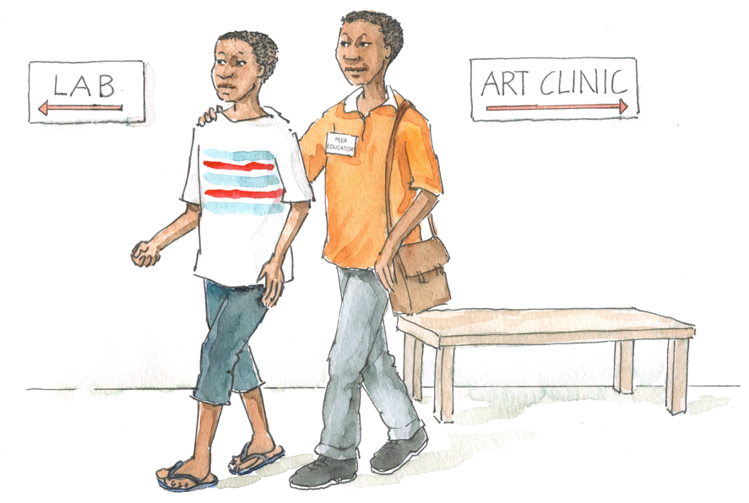
Brainstorming
Based on your experiences, what are the key steps to implementing an Adolescent Peer Educator program?

Slide 36
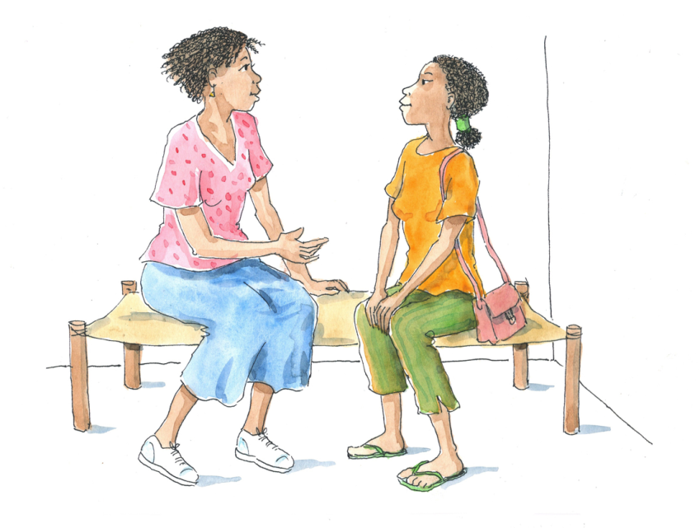
10 Key Steps to Implementing a Facility-based Adolescent Peer Educator Program
Conduct a participatory situational analysis and needs assessment.
Engage stakeholders in participatory program design.
Define program indicators, set targets, and develop tools.
Develop a detailed budget and workplan.
Recruit Adolescent Peer Educators, based on selection criteria.

Slide 37
10 Key Steps to Implementing a Facility-based APE Program (Continued)
Adapt or develop a training curriculum.
Train Adolescent Peer Educators.
Engage health facility teams to rollout peer education activities.
Provide ongoing support, supervision, and mentoring to Adolescent Peer Educators.
Continuously monitor, evaluate, and adjust the program.
ICAP developed a generic training curriculum for Adolescent Peer Educators that can be adapted to a variety of settings.

Slide 38
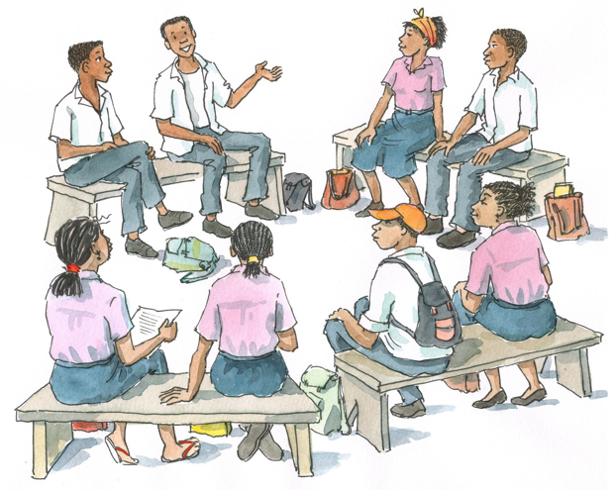
Discussion Questions
Based on your experience, what are the roles and responsibilities of Adolescent Peer Educators within the clinic setting?
What should Adolescent Peer Educators NOT be asked to do?
What should be the selection criteria for Adolescent Peer Educators?

Slide 39
Sample Selection Criteria for APEs
Older adolescent
Living positively with HIV
Adhering to care and medications
Open-minded and non-judgemental attitude
Has basic literacy and numeracy skills
Has good interpersonal and oral communication skills
Committed to working with other ALHIV
Self-confident
Self-disciplined and able to work both independently and as part of a team
Available/has time
Represents the age, ethnicity, socio-economic status, gender, language preferences, and other characteristics of adolescent clients
Others…
See Appendix 12B: Template for Adolescent Peer Educator Job Description.

Slide 40
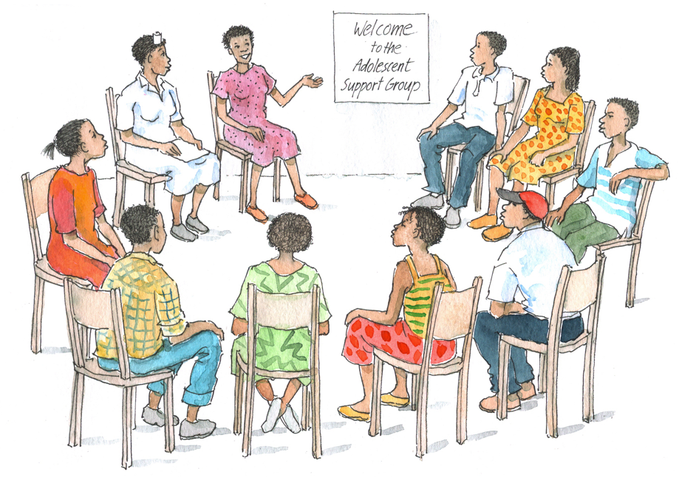
Discussion Questions
If you already have an Adolescent Peer Education program in your facility, how could it be improved?
If you do not, do you think it would be feasible to start one at your facility? What would be the next steps?
What do/will the Adolescent Peer Educators do? What would you NOT expect them to do?
How will they be selected? Trained? Supervised?

Slide 41
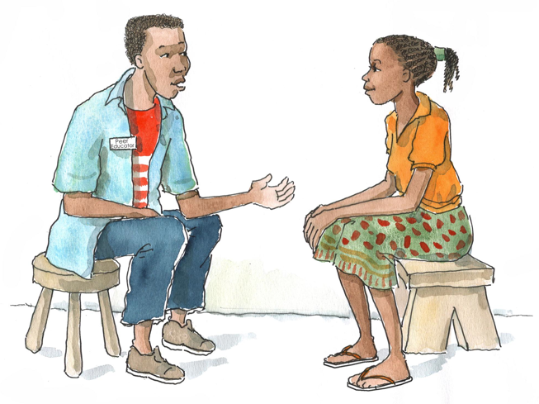
Remember:
Peer education can be a powerful approach to improving the youth-friendliness and quality of adolescent HIV care and treatment services.
Careful planning, clear objectives, regular supervision, and good communication are essential for successful implementation of an Adolescent Peer Education program.

Slide 42
Questions or comments on this session?

Slide 43
Module 12: Key Points
Linkages to community resources and support are important to help ALHIV and their caregivers get the services and support they need across the continuum of HIV care.
There are many ways to strengthen facility-community linkages.
Health workers should stay up-to-date on which services are available for ALHIV and their caregivers/families and should maintain a directory of these services to facilitate the making of referrals.

Slide 44
Module 12: Key Points (Continued)
PLHIV participation in all aspects of HIV programs is critical to ensure that programs meet client needs.
Two important ways to include adolescents are through Adolescent Peer Education programs and through CABs.
Adolescent Peer Educators can give meaningful feedback to health care programs, offering insights into the best ways to retain young people in care and support their adherence to treatment.
Peer education can be a powerful approach to improving the youth-friendliness and quality of services. However, such programs require careful planning, clear objectives, regular supervision, and good communication.

