Slide 1
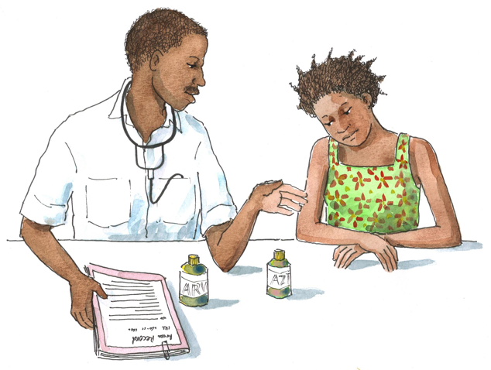
Adolescent HIV Care and Treatment
Module 14:
Monitoring, Evaluation, and Quality Improvement

Slide 2
Module 14 Learning Objectives
After completing this module, participants will be able to:
Discuss the importance of routinely monitoring adolescent HIV care and treatment activities
Discuss how information from monitoring and evaluation (M&E) can be used to support program improvement
Describe the purpose of quality improvement (QI)
Define and describe supportive supervision

Slide 3
Session 14.1
Monitoring, Evaluation, and Data Collection

Slide 4
Session 4.1 Objective
After completing this module, participants will be able to:
Discuss the importance of routinely monitoring adolescent HIV care and treatment activities
Discuss how information from monitoring and evaluation (M&E) can be used to support program improvement

Slide 5
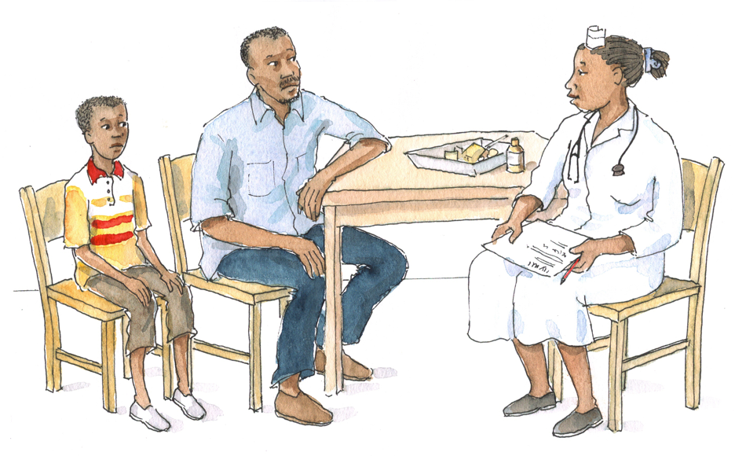
Discussion Questions
Why do you think it is important to keep records and to monitor our work with adolescents?
Do you know how the data you record is used at the facility level? At the district and national levels?
Have you ever received feedback on the data you submit?

Slide 6
Monitoring
Is the routine process of data collection and measurement of progress toward program objectives
Involves COUNTING what we are doing and routinely checking the quality of services
Is a process that helps to identify problems early so that they can be corrected quickly
Requires that data be collected, compiled, and analyzed on a routine basis

Slide 7
Monitoring (Continued)
Health workers play a vital role in the monitoring process by regularly recording, compiling, and reporting data to determine, for example:
  # of adolescents enrolled in HIV care
  # of adolescents receiving ART
  # of adolescents retained in care over time
  Types of clinical and support services offered to adolescents
Remember that facility-level reports are aggregated up to district and national levels, and that they also form part of international progress reports.

Slide 8
Monitoring (Continued)
M&E of adolescent HIV care and treatment programs can help to:
  Assess whether a program is meeting its targets
  Identify and improve problem areas in the implementation of adolescent services
Routing M&E are necessary to gather information on care and treatment program outcomes, such as:
  Is the program retaining adolescent clients in care?
  Are all eligible adolescents receiving ART?
  Are routine lab tests and clinical follow-up visits being conducted on schedule?

Slide 9
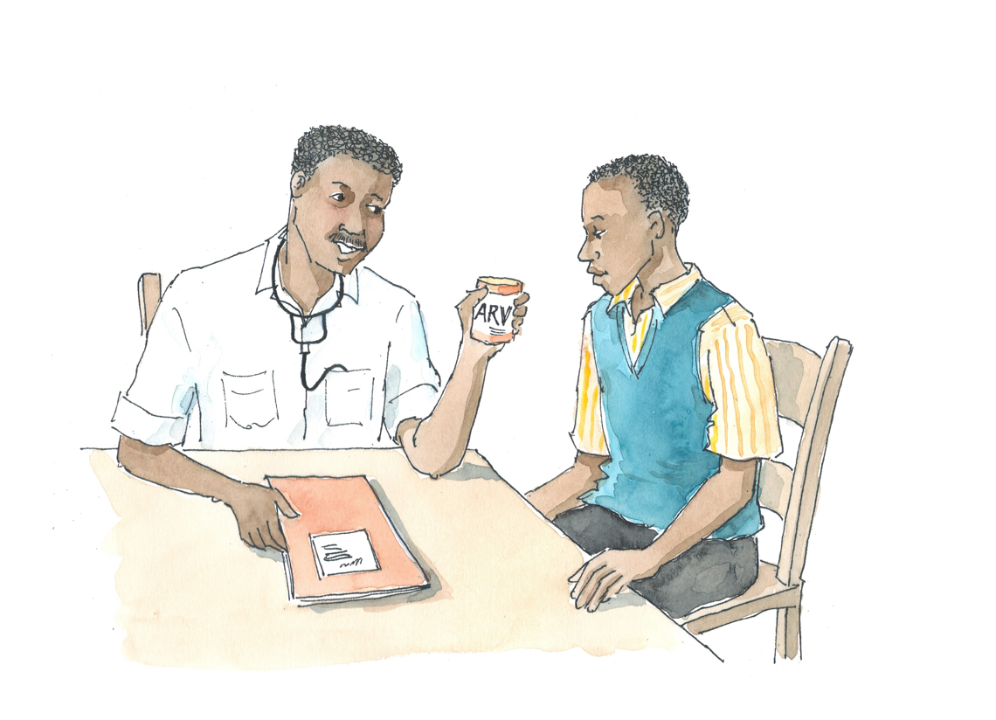
Remember:
Program outcomes are usually the cumulative tally of individual outcomes.
M&E data can be used to monitor progress in the implementation of adolescent care and treatment services at the facility, district, and national level.

Slide 10
Discussion Questions
What is the age breakdown of data at your facility (e.g. often, it is <15 years and >15 years for HIV care and treatment programs)?
What does it mean to disaggregate data, specifically thinking about HIV services?
How could further disaggregating our clinic data help us? What age groups would you use?

Slide 11
Disaggregating Data
Often, programs separate data into only 2 age groups: under 15 and over 15 years.
If possible, program data should be collected and analyzed using the following age groups:
  Ages 10-15 (early adolescence)
  Ages 16-19 (late adolescence)
  Ages 20-25 (early adulthood)
This gives us more detailed information and allows for more meaningful interpretation of program outcomes.

Slide 12
Discussion Questions
What are “indicators?” Can you give an example of an adolescent care and treatment indicator?
What are “targets?” Can you give an example of an adolescent care and treatment target?

Slide 13
Indicators
Indicators are summary measures used to help indicate the status of a program’s activities (see Table 14.1 for examples).
Pediatric and adult HIV care and treatment indicators are established at the national level.
Generally cover service delivery to PLHIV, quality of care, and management-related info
Indicators can be calculated at the facility, district, or national level, depending on need and how these data will be used.

Slide 14
Indicators (Continued)
Some facilities have their own indicators, in addition to those established nationally.
  Can identify progress, problems, challenges, and solutions in service delivery at specific facilities (e.g.,the # of ALHIV who miss clinic appointments)
Indicators may need to be revised periodically.
Indicators reflect a certain timeframe (e.g., month, quarter).
It is important to measure changes in indicators over time.

Slide 15
Indicators (Continued)
It is also good to calculate proportions, which give more useful and comparative info than raw numbers alone.
Because measuring proportions is often difficult to do, programs may wish to select a small number of priority proportions to measure.
For examples, see Appendix 14A: ICAP’s Adolescent Standards of Care.

Slide 16
Targets
Targets are specific goals established before a new program or service is implemented and on a regular basis thereafter.
For example, a target may be, “To ensure that 95% of eligible adolescent clients initiate ART.”
See Table 14.2 for examples of priority targets for adolescent HIV care and treatment programs.

Slide 17
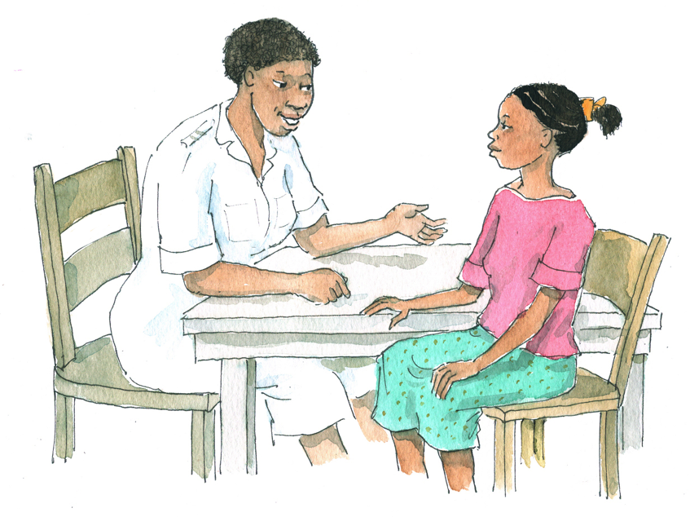
Discussion Question
What is “evaluation?” What questions might an evaluation answer?

Slide 18
Evaluation
Evaluation is the process of tracking changes in indicators that reflect service delivery and determining whether pre-established targets have been reached.
Evaluations:
Help us understand what indicators are really telling us
Help us take a closer look at outcomes of interest and can help answer questions about what these outcomes mean
Are typically conducted at specific time periods (e.g. at the end of a year), whereas monitoring happens on a more regular basis
At their simplest, will demonstrate to what extent planned activities are actually realized, by comparing targets with indicator measurements (e.g., What % of the target for ART initiation did the program reach last year?)

Slide 19
Evaluation (Continued)
Evaluation can also involve research methods to systematically investigate a program’s effectiveness.
One might use evaluation to answer the following program questions:
  Are adolescents enrolled in a peer support group more likely to return for scheduled appointments compared to adolescents who do not participate in peer support groups?
  Are adolescents enrolled in the program experiencing a better quality of life?
  Has the program reduced the number of adolescents hospitalized for HIV-related illnesses?

Slide 20
Evaluation (Continued)
Evaluations should be conducted regularly to look at changes that occur as the adolescent HIV program is implemented and maintained.
This will enable program staff to identify areas of program strength and weakness, and to respond to weaknesses by investigating and correcting problems.

Slide 21
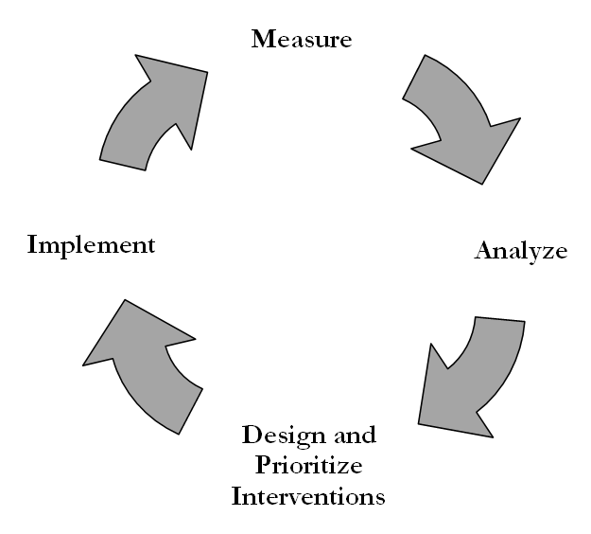
Evaluation (Continued)
M&E is a CONTINUOUS process.

Slide 22
Discussion Questions
At your clinic, how are the monthly summary forms and reports completed? To whom are they submitted?
These reports are analyzed at the district — is there someone at your clinic who analyzes them as well?
What is done with the information in these monthly reports? Is it ever used to improve/modify services?

Slide 23
Reporting Steps/Flow
Individual client data recorded in charts, records, and/or registers
Health facility level:
Register data tallied, totals recorded on monthly summary form, and monthly report compiled
Monthly summary forms submitted to district level
District level:
Monthly summary forms collated and submitted to national level
National level:
Collated district data
23

Slide 24
Remember:
All staff must be aware of the importance of completing registers in an accurate way.
Monthly summary forms and reports will only be accurate if registers are completed correctly and consistently!
Key staff should review their facility’s monthly report to ensure that activities will meet targets and goals.
Program successes and weaknesses, along with a monthly data summary, should be reviewed at multidisciplinary team meetings.

Slide 25
Program Modification
At every level of the system, monthly summary forms should lead to discussion on how the program can be modified to better meet targets.
Such program improvements will require discussion of the following:
What is the problem?
How will we address the problem?
What is our plan?
How will we know if the plan is working?

Slide 26
Adolescent HIV Care and Treatment Data Collection and Forms
Standard data collection and accurate recording of activities and outcomes are essential.
Data collection for adolescent HIV care and treatment is usually done through the existing national M&E system.
There is not usually a separate system with adolescent-specific forms.
  In most cases, adolescent data will be captured in the national forms for pediatric HIV.
  This is why it is particularly important that data are appropriately disaggregated by age.
  Note that facilities should use national forms for adult HIV care and treatment for ALHIV receiving care in adult HIV clinics.

Slide 27
Adolescent HIV Care and Treatment Data Collection and Forms (Continued)
Effective M&E systems require record keeping that is:
  Accurate – In other words, correct and true
  Reliable – Completed the same way every time
  Standardized – Recorded using the same tools in every clinic in the country
  Recorded following established guidelines

Slide 28
Adolescent HIV Care and Treatment Data Collection and Forms (Continued)
In facilities with established adolescent programs, adolescents may be “transferred out” of pediatric registers as they age and “transferred in” to adult registers.
  If no national guidelines can be identified for this procedure, facilities should have their own consistent procedure for counting these ALHIV.

Slide 29
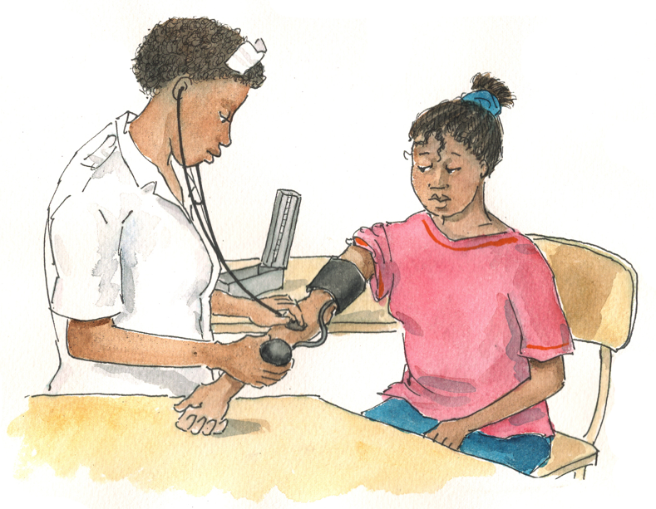
Remember:
Systems for documenting care and treatment activities must maintain client confidentiality.
It is the responsibility of all staff members who complete registers or summary forms to ensure that data are accurate and complete and that data collection protocols are followed.

Slide 30
Adolescent HIV Care and Treatment Data Collection and Forms (Continued)
Some of the key registers and forms facilities use to monitor activities in their adolescent programs:
Ward or clinic register
General HIV counseling and testing register
Patient care card
HIV care summary sheet
Pediatric clinical follow-up form
Pediatric ART eligibility form
Pediatric adherence form
Pharmacy logbook/register
Patient status form
TB diagnostic worksheet and TB screening tool
Pediatric patient locator form

Slide 31
Registers and Forms Used in Our Setting
Now, let's review the national registers and forms used to provide data on HIV care and treatment for adolescents.
Remember that you will have a chance to practice filling in these forms during the practicum session.

Slide 32
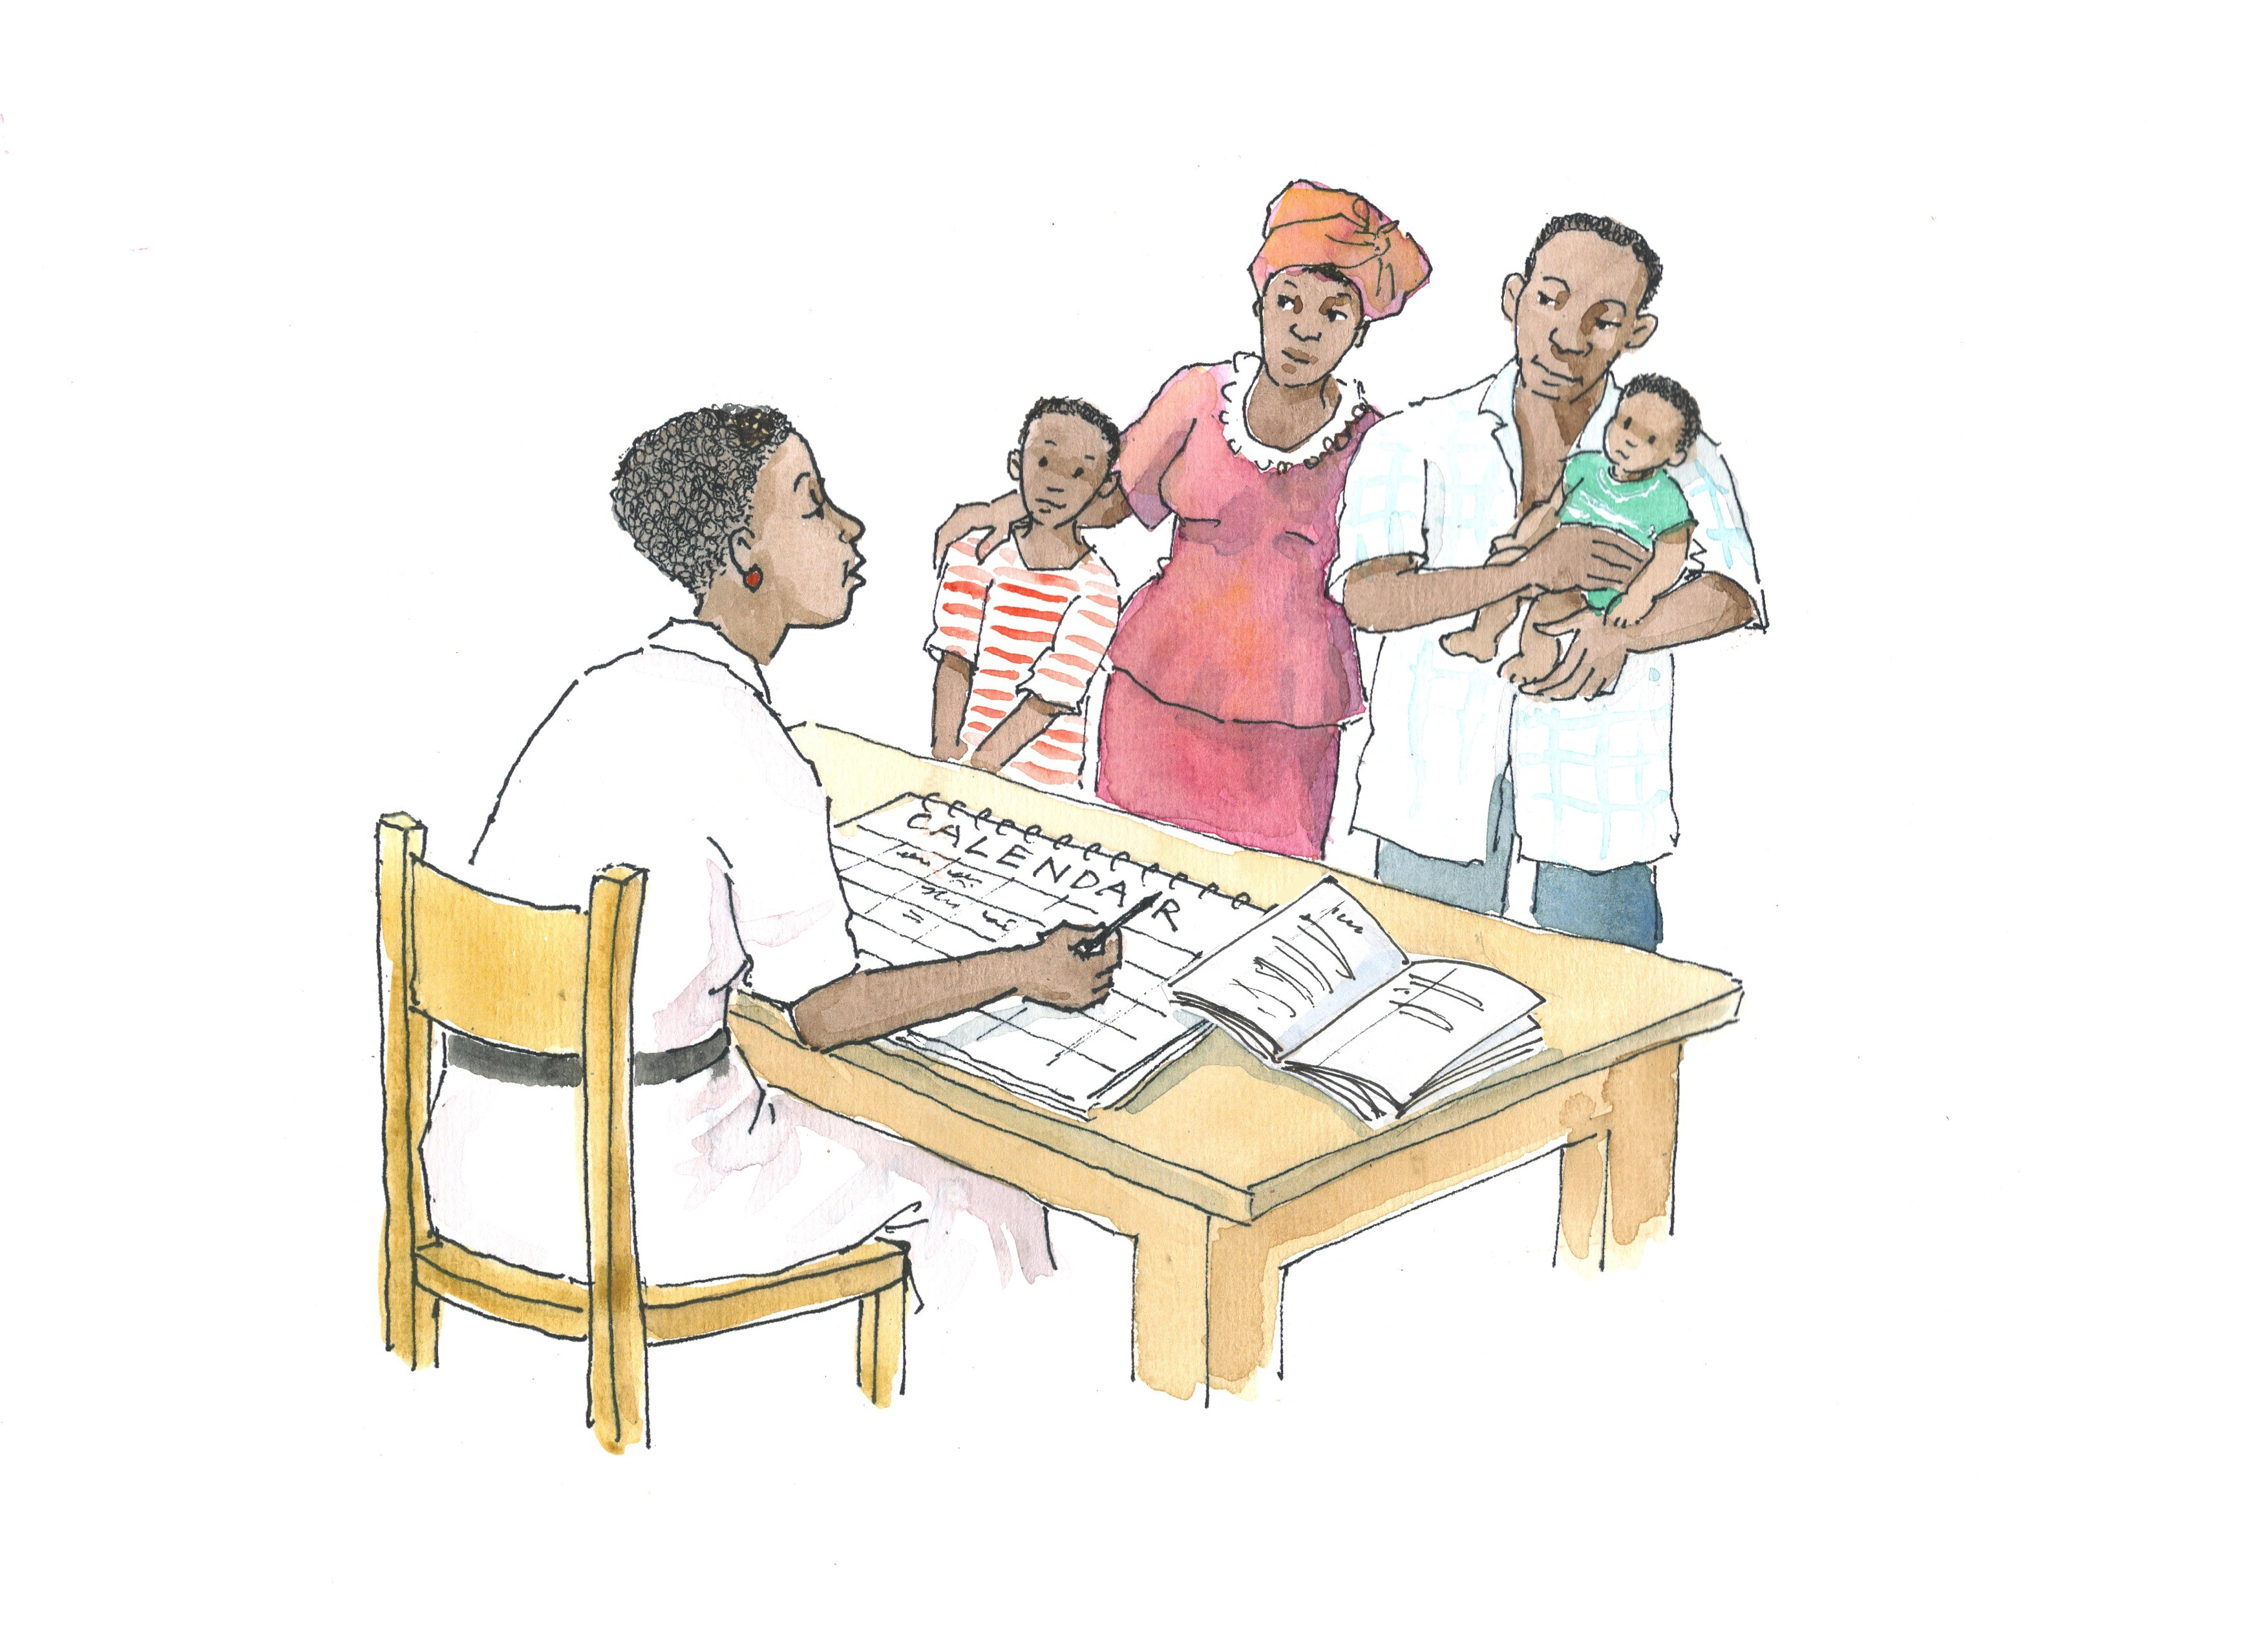
Discussion Questions
What appointment and tracking systems exist in your facility?
Why are appointment and tracking systems important for adolescent care and treatment?
How might you improve these systems the future?

Slide 33
Tracking Missed Appointments
Health facilities should use an appointment book to track upcoming and missed appointments.
Health facilities should also develop a follow-up system to contact clients and caregivers when an appointment has been missed.
A follow-up system requires:
  A working appointment system
  A means of contacting clients (via cell phone or home visits)
  The consent of adolescent clients and/or their caregivers to follow up via phone or home visit (should be documented in the clinic record)

Slide 34
Exercise 1
Using Data for Decision-Making: Small group work and large group discussion
34

Slide 35
Exercise 1: Small Group Work (Part 1)
Review the data in Table 14.3.
Calculate the “% of Target” in the last column, based on the data provided.
Discuss the following questions:
  For which indicators is Clinic Make Believe doing well and meeting its targets? How do you know?
  For which indicators is Clinic Make Believe NOT meeting its targets? How do you know?
  If the number of adolescents enrolled in care in Q4 (the 4th quarter) of 2009 was 450 and the number of adolescents receiving ART was 290, would you say the clinic is doing better or worse enrolling clients in ART in 2010?
  Which areas should the staff of Clinic Make Believe focus on improving?

Slide 36
Exercise 1: Small Group Work (Part 2)
Identify one of the areas that needs improvement at Clinic Make Believe and discuss:
  What is the problem?
  How should we (assuming we are the managers at Clinic Make Believe) address the problem?

Slide 37
Exercise 1: Small Group Presentations and Large Group Discussion
Report back on Part 1 of small group work and discussion.
Report back on Part 2 of small group work and discussion.
  Did any group choose a different indicator for Part 2?

Slide 38
Exercise 1: Debriefing
What did we learn?
Key points:
  A close review of the data in routine summary reports can provide much information about the strengths and weaknesses of a program.
  It is important to compare the current period’s data with data from the previous period (or against targets). Otherwise, you won’t know if the data represent an improvement or a decline.
  When comparing raw data against targets, calculate percentages to get a better sense of progress or to compare with earlier periods.

Slide 39
Questions or comments on this session?

Slide 40
Session 14.2
Quality Improvement and Supportive Supervision

Slide 41
Session 14.2 Objective
After completing this session, participants will be able to:
Describe the purpose of quality improvement (QI)
Define and describe supportive supervision

Slide 42
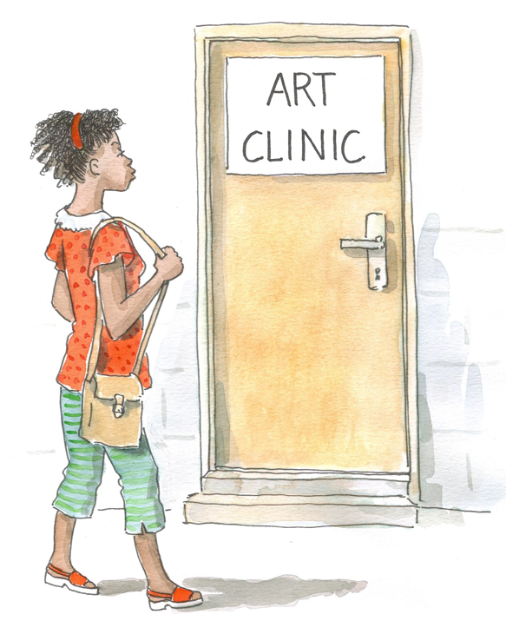
Discussion Questions
42
What does “quality” mean to you when thinking about adolescent HIV care and treatment services?
How do you think facility managers would define quality? What about adolescent clients?
How do you think monitoring and evaluation and QI are related?

Slide 43
Quality Improvement (QI)
The means by which activities are routinely evaluated to check whether services are following established guidelines and standard operating procedures (SOPs)
May also be referred to as quality assurance (QA)
Different from M&E
Should be a routine, ongoing part of the normal functioning of health facilities
Should incorporate procedures in which all staff, at all levels, are involved
The purpose of QI is to identify problems (in service delivery, in data, or in both) so they can be corrected, thereby improving services for adolescent clients and their families.

Slide 44
Methods to Assess Quality
It is often necessary to use a variety of methods to assess program quality.
Standard monitoring tools capture only a fraction of the services provided to adolescents and they provide no information on the quality of those services.
  For example, forms and registers do not give us information on the youth-friendliness of services or the quality of psychosocial support, adherence, or counseling sessions.

Slide 45
Methods to Assess Quality (Continued)
QI Activities Might Examine/Evaluate:
The quality and youth-friendliness of services
Compliance with national guidelines, SOPs, and protocols for HIV care and treatment
The adequacy of space and the attention to privacy and confidentiality
Linkages to ongoing support and community-based services

Slide 46
QI Activities Might Include:
Periodic reviews of records followed by staff feedback
Defining and regularly measuring adolescent SOCs (see Appendix 14A)
Direct observation of clinical procedures and counseling sessions
Periodic assessments of the youth-friendliness of services
Interviews with staff to obtain feedback on specific indicators
Individual interviews or focus groups with ALHIV
Individual interviews or focus groups with caregivers of ALHIV
Exit interviews or surveys completed anonymously by clients
Evaluation of physical space, client flow, and time concerns
Meeting with representatives of services where ALHIV and caregivers are referred

Slide 47
How Often Should QI be Conducted?
During initial implementation: daily or weekly
As services become established: reviews should become a formal part of overall program monitoring activities at designated intervals (monthly progressing to quarterly reviews)
It is important to set up an established time for multidisciplinary teams and managers to discuss QI findings and issues, and to plan the way forward (for example, through monthly or quarterly meetings).

Slide 48
Discussion Questions:
What possible solutions/interventions to the following problems might be identified through QI activities?
Older adolescents often miss their clinic appointments.
There has been an increase in the number of adolescent clients presenting with STIs.
Many younger adolescent clients have not been fully disclosed to and therefore do not understand why they need to take medicines every day.
Regular attendance of the support group is low and adolescent clients think it is a “waste of time.”

Slide 49
Discussion Questions:
Have you received or provided “supportive supervision” in your work? Please explain.
What are the qualities associated with “supportive supervision?” For example, if you were expanding adolescent HIV care and treatment services within your facility, what could your supervisor do to help and support you to set up these services?

Slide 50
Supportive Supervision
QI activities include assessing results of each QI review and planning a response.
Often, identified weaknesses require supervisors to work directly with staff to address underlying problems.
QI activities are not only the responsibility of supervisors – all staff should be part of the continuous QI process.

Slide 51
Supportive Supervision (Continued)
Supportive supervision is an important component of responding effectively to QI findings.
Supportive supervision is an approach in which supervisors work with staff to:
  Establish goals
  Monitor performance
  Identify and correct problems
  Proactively improve the quality of services
QI is most effective when the focus is on providing guidance and mentorship and using group problem solving to help health workers correct problems and overcome barriers.

Slide 52
Supportive Supervision Aims To:
Obtain information on program functioning and quality
Improve HW performance by providing one-to-one support
Acknowledge good practices by providing positive feedback
Involve supervisors, HWs, and volunteers to improve service provision
Facilitate on-site, participatory problem-solving
Involve youth in giving feedback and improving service provision
Assure that the program is successful in meeting the needs of ALHIV/caregivers
Motivate staff and volunteers

Slide 53
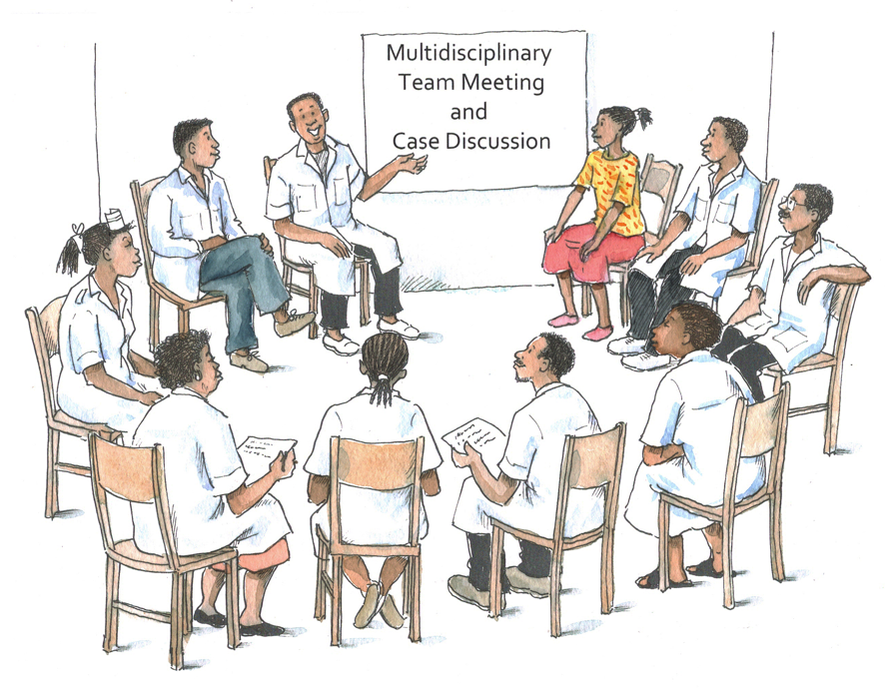
Remember:
Once a deficiency in service provision is identified, supportive supervision must be established as quickly as possible to prevent poor practices from becoming routine.

Slide 54
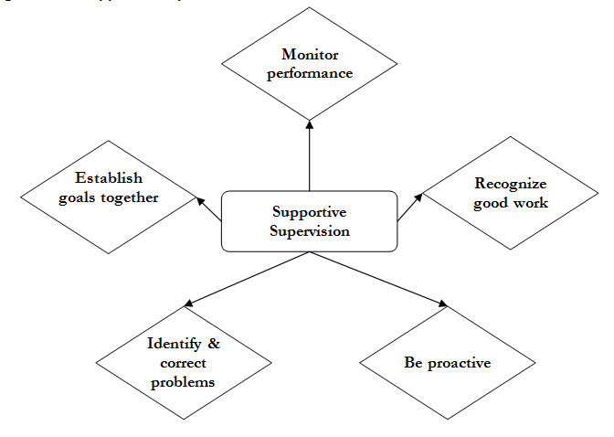
Supportive Supervision Process

Slide 55
Questions or comments on this session?

Slide 56
Module 14: Key Points
Monitoring and evaluation (M&E) is the standardized process by which data related to the delivery of services are collected and evaluated.
M&E is a continuous process that informs the planning and implementation of adolescent HIV care and treatment services.
Indicators are calculated using routinely collected data. They can be calculated at the facility, district, or national level.
Targets are specific goals established before a new program or service is implemented or at other specific times.

Slide 57
Module 14: Key Points (Continued)
Standard national forms and registers are used to collect key data on adolescent HIV care and treatment services.
If possible, program data should be collected, disaggregated (or separated), and analyzed by the following groups: ages 10-15; ages 16-19; and ages 20-25.
Key staff should review their facility’s monthly forms/reports to ensure that activities will meet targets and goals. Program successes and weaknesses should be reviewed at multidisciplinary team meetings.
Patient confidentiality must be always be maintained.

Slide 58
Module 14: Key Points (Continued)
Quality Improvement (QI) is the means by which activities are routinely evaluated to check whether services offered are following established guidelines and SOPs.
QI should be a routine, ongoing part of the normal functioning of health facilities.
A variety of methods may be used to conduct QI.
An important component of responding effectively to QI findings is to provide supportive supervision.
Supportive supervision requires collaboration between the supervisor and staff to establish goals, monitor performance, and identify and correct problems.

