Slide 1
Adolescent HIV Care and Treatment
Module 16:
Action Planning, Course Evaluation, and Closure

Slide 2
Module 16 Learning Objectives
After completing this module, participants will:
Have reviewed the key steps and considerations of initiating or scaling up adolescent HIV care and treatment services
Have identified the potential challenges to implementing adolescent HIV care and treatment services at their site, and potential solutions to those challenges
Have started developing a site-specific action plan to initiate or improve adolescent HIV care and treatment services

Slide 3
Module 16 Learning Objectives (Continued)
Have discussed whether or not the training objectives were achieved
Have reflected on the concerns, expectations, and strengths discussed on the first training day
Have listed next steps, including training follow-up and supportive supervision
Have completed the training post-test
Have evaluated the training and given suggestions for improvement

Slide 4
Session 16.1
Site-Specific Adolescent HIV Care and Treatment Implementation and Action Planning

Slide 5
Session 16.1 Objectives
After completing this session, participants will:
Have reviewed the key steps and considerations of initiating or scaling up adolescent HIV care and treatment services
Have identified the potential challenges to implementing adolescent HIV care and treatment services at their site, and potential solutions to those challenges
Have started developing a site-specific action plan to initiate or improve adolescent HIV care and treatment services

Slide 6
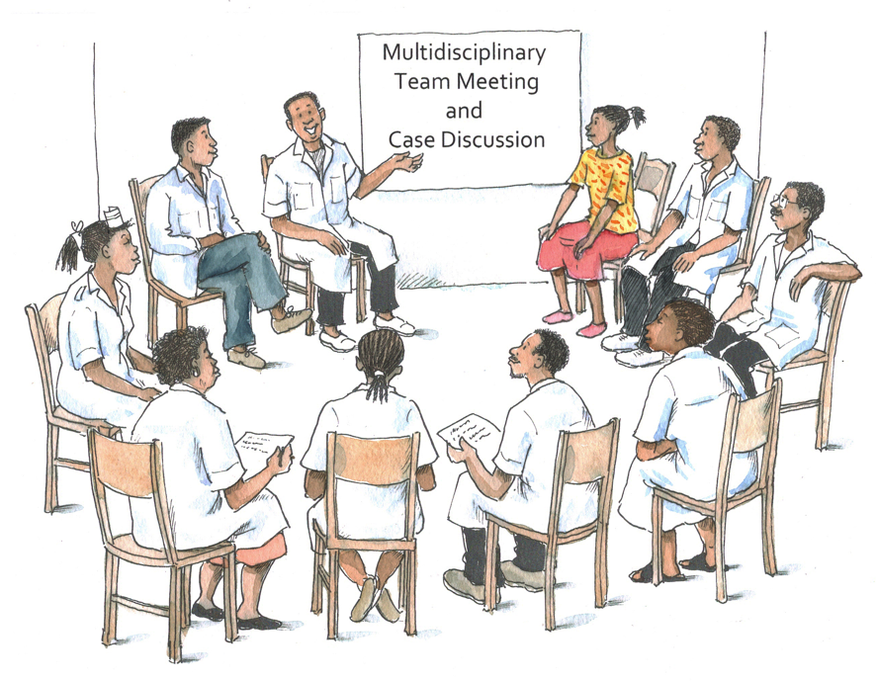
Discussion Question
What do you think are the key steps to improving or expanding services for ALHIV at your health facility?

Slide 7
Key Steps to Initiate or Scale-up Adolescent HIV Services
Conduct a needs assessment
Develop an action plan
Present the action plan to managers, health workers, and youth
Regularly revisit the action plan to assess progress
Setting up youth-friendly services is a
start, but in order to really meet the needs of ALHIV, quality, evidence-based HIV care must be provided within the context of youth-friendly services.

Slide 8
Characteristics of Youth- Friendly Services
See Table 16.1: “Characteristics of Youth-Friendly Services.“
  Health worker characteristics
  Health facility characteristics
  Program design characteristics
There are many ways to improve the youth-friendliness of services. Additional resources and staff are often not required, and sometimes even small changes can have a big impact.

Slide 9
Exercise 1
Action Planning: Small group work and large group discussion
(See Appendix 16A: Adolescent HIV Care and Treatment Action Planning and Implementation Template.)

Slide 10
Exercise 1: Small Group Work
Break into small groups, by facility.
Assign a facilitator and a notetaker.
Discuss and fill in Appendix 16A, thinking about what you would like to achieve in the next 6 months.
  Make sure to discuss anticipated challenges and possible solutions.
At the end, draw a star next to the top 5 priority actions.

Slide 11
Exercise 1: Report Back and Large Group Discussion
Give 5-minute presentation on your group’s discussion, focusing on the priority items on your action plan.
Discussion of next steps for the action plans

Slide 12
Exercise 1: Debriefing
What did we learn?
Key points:
  It is important to start a specific action plan now while everything learned during the training is still fresh in everyone’s minds.
  Share the action plan with colleagues, managers, and supervisors and ask for feedback.
  Update the action plan regularly, perhaps every 3 to 6 months at first.
12

Slide 13
Questions or comments on this session?
13

Slide 14
Session 16.2
Reflection on Training Objectives and Concerns, Expectations, and Strengths

Slide 15
Session 16.2 Objectives
15
After completing this session, participants will:
Have discussed whether or not the training objectives were achieved
Have reflected on the concerns, expectations, and strengths discussed on the first training day
Have listed next steps, including training follow-up and supportive supervision

Slide 16
Congratulations on a Job Well Done!
Let's review the training objectives we discussed at the start of the training.
For each, discuss:
Did we meet this learning objective during the training?
How confident do you feel that you will be able to do this when you return to your health facility?
What extra support would you like in this area?

Slide 17
Adolescent HIV Care and Treatment Training Objectives
Describe the stages and characteristics of adolescence and the unique needs and challenges of adolescent clients
Implement strategies to make HIV-related services youth-friendly
Define and implement the package of HIV-related care and treatment services for adolescents
Demonstrate effective communication and counseling skills with adolescent clients
Conduct a psychosocial assessment and provide ongoing psychosocial support services to adolescent clients

Slide 18
Adolescent HIV Care and Treatment Training Objectives (Continued)
Describe the importance of mental health services for adolescent clients, recognize when a mental health problem may exist, and provide appropriate referrals and support
Recognize the signs of and screen for alcohol and substance use disorders among adolescents, and provide support and referrals
Provide developmentally appropriate disclosure counseling and support to adolescents and, where appropriate, their caregivers

Slide 19
Adolescent HIV Care and Treatment Training Objectives (Continued)
Provide developmentally-appropriate adherence preparation and ongoing adherence support to adolescent clients and caregivers
Support adolescents to live positively with HIV
Conduct sexual risk screening and provide non-judgmental, comprehensive counseling on sexual and reproductive health to adolescent clients
Provide basic, non-judgmental contraceptive counseling and services to adolescent clients

Slide 20
Adolescent HIV Care and Treatment Training Objectives (Continued)
Describe the key components of PMTCT services for adolescents and provide referrals and support along the continuum of PMTCT care
Describe ways to link adolescents with needed facility and community-based support services
Describe and implement activities to meaningfully involve adolescent clients in clinical services, such as through adolescent peer education programs
Prepare and support adolescent clients throughout the transition to adult care

Slide 21
Adolescent HIV Care and Treatment Training Objectives (Continued)
Remember: Ongoing support, mentoring, and technical assistance will be provided to help you and your team implement the skills, knowledge, and action plans developed during this training.
21
Describe how monitoring and evaluation can be used to support adolescent HIV program improvements
Demonstrate core competencies in adolescent HIV care and treatment services in a clinical setting
Develop a site-specific action plan for implementing adolescent HIV care and treatment services

Slide 22
Concerns, Expectations, and Strengths
Let’s reflect on the concerns, expectations, and strengths we discussed at the start of the training.
Strengths
  Would anyone like to add to the strengths list?
Concerns
  Would anyone like to discuss their current perspective on the concerns listed during the “Getting to know each other” exercise?
Expectations
    Were your expectations met? Are there expectations that were not met during the training?

Slide 23
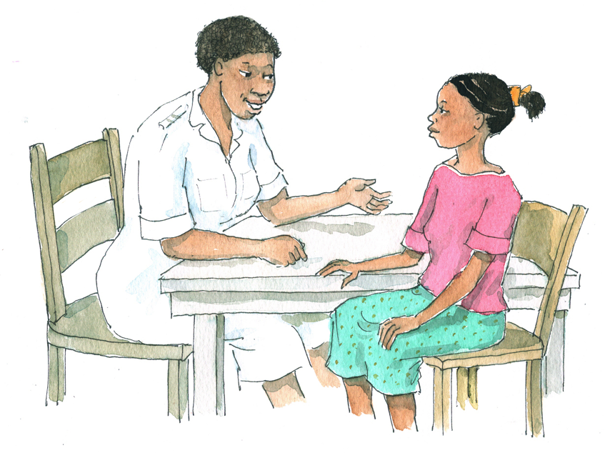
Discussion Questions
What was the most valuable information or skill you learned during this training?
What is 1 action that you will prioritize in your work with adolescents living with HIV?

Slide 24
Questions or comments on this session?
24

Slide 25
Session 16.3
Post-test, Training Evaluation, and Closing

Slide 26
Session 16.3 Objectives
After completing this session, participants will:
Have completed the training post-test
Have evaluated the training and given suggestions for improvement

Slide 27
Training Post-Test
The objective of this post-test is to find out what the group as a whole knows about adolescent HIV care and treatment and how much the group’s knowledge has improved since the pre-test.
Results of the pre- and post-tests will help improve future trainings and will provide information on ongoing mentoring and supervision needs.
Remember to record the same number on your post-test as the one you recorded on your pre-test!
See Appendix 16B: Post-Test — you have 20 minutes to complete the post-test.

Slide 28
Post-test Debriefing
How did you feel answering the questions today, compared with on the first day of training?
Now we will review the correct answers as a group.

Slide 29
Review of Post-Test Questions and Answers (Continued)
Q.1 Which of the following statements are factors to be considered in the scale up of adolescent HIV care and treatment services? (select all that apply)
    Young people are no more vulnerable to HIV than adults.
    Youth living with HIV face unique health, adherence, and psychosocial issues and challenges.
    Health workers need specific knowledge and skills to meet the needs of adolescent clients.
    Programs and clinical services need to be youth-friendly to attract and retain adolescent clients.

Slide 30
Review of Post-Test Questions and Answers (Continued)
Q.2 Adolescence is a unique stage of life that is characterized by:
    Challenging caregivers or elders
    A focus on body image
    A sense of immortality
    Significant physical, emotional, and mental challenges
    All of the above

Slide 31
Review of Post-Test Questions and Answers (Continued)
Q.3 Which of the following are characteristics of “youth-friendly” services? (select all that apply)
      There are special days/times set aside for young people to receive services.
      Young clients can only come to the clinic when they have a scheduled appointment.
      Young people are involved in designing and monitoring programs.
      Multiple services are available in one clinic, known as “one-stop shopping.”
      Health workers mainly use group counseling in order to save time.

Slide 32
Review of Post-Test Questions and Answers (Continued)
Q.4 To be effective, the adolescent package of care must ensure: (select all that apply)
        The integration of services
        That services are age- and developmentally-appropriate
        That the needs of both perinatally infected adolescents and those infected later in childhood or adolescence are met
        That services encourage adolescents to take responsibility for their own health
        That adolescent clients receive care in the pediatric clinic for life

Slide 33
Review of Post-Test Questions and Answers (Continued)
Q.5 The adolescent package of HIV care closely resembles the package of HIV care for adults; however, the way services are delivered can impact their success among adolescents.
      True
      False

Slide 34
Review of Post-Test Questions and Answers (Continued)
Q.6 Adolescent clients should be started on ART when their CD4 cell count is:
        200 or less
        250 or less
        300 or less
        350 or less
        None of the above

Slide 35
Review of Post-Test Questions and Answers (Continued)
Q.7 How frequently should CD4 cell count be monitored in adolescent clients?
        Every 12 months; but 6 monthly as CD4 count approaches threshold (to initiate ART)
        Every 9 months; but 4 monthly as CD4 count approaches threshold
        Every 6 months; but 3 monthly as CD4 count approaches threshold
        Every 4 months; but 2 monthly as CD4 count approaches threshold
        Every 2 months; but monthly as CD4 count approaches threshold

Slide 36
Review of Post-Test Questions and Answers (Continued)
Q.8 Counseling includes which of the following? (select all that apply)
        Solving another person’s problems
        Helping another person make informed decisions
        Telling another person what to do
        Respecting everyone’s needs, values, culture, religion, and lifestyle
        Recording key points of the counseling session in the client’s clinic file

Slide 37
Review of Post-Test Questions and Answers (Continued)
Q.9 Counseling includes which of the following? (select all that apply)
        Solving another person’s problems
        Helping another person make informed decisions
        Telling another person what to do
        Respecting everyone’s needs, values, culture, religion, and lifestyle
        Keeping good records

Slide 38
Review of Post-Test Questions and Answers (Continued)
Q.10 Which of the following are coping strategies that health workers should suggest to adolescent clients to help them reduce stress and promote their psychosocial well being? (select all that apply)
        Talking with a Peer Educator
        Joining a support group
        Exercising
        Disclosing their HIV-status to all of their friends
        Participating in recreational activities, like sports or youth clubs

Slide 39
Review of Post-Test Questions and Answers (Continued)
Q.11 Which of the following statements about mental illness are correct? (select all that apply)
        Mental health problems are very rare among adolescents living with HIV.
        Mental illness and substance abuse are closely related.
        Only trained psychologists and psychiatrists can recognize the signs of possible mental illness in adolescents.
        Adolescents are susceptible to depression, anxiety disorders, behavioral disorders, and alcohol/substance use disorders.
        All clinics should have standard procedures on how to manage adolescent clients with possible or confirmed mental illness.

Slide 40
Review of Post-Test Questions and Answers (Continued)
Q.12 Disclosure to a child or adolescent is a one-time event for which the caregiver must be well-prepared.
        True
        False

Slide 41
Review of Post-Test Questions and Answers (Continued)
Q.13 Which of the following statements about disclosure are true? (select all that apply)
        Health workers can work with caregivers to develop and implement a disclosure plan; they can also play a supportive role throughout the disclosure process.
        Research shows that disclosing a child/young adolescent’s HIV-status often results in psychological problems, emotional harm, and difficulties with adherence.
        There are times when health workers may need to facilitate disclosure discussions with children/young adolescents.
        It is recommended that children/young adolescents be fully disclosed to when they are developmentally ready — typically by the time they are 10-12 years old.
        Health workers should encourage older adolescents not to disclose to their friends because they may face stigma and discrimination.

Slide 42
Review of Post-Test Questions and Answers (Continued)
Q.14 Adherence preparation and ART initiation can usually be completed in 1 visit.
        True
        False

Slide 43
Review of Post-Test Questions and Answers (Continued)
Q.15 The only reliable way to assess client adherence is with pill counts.
        True
        False

Slide 44
Review of Post-Test Questions and Answers (Continued)
Q.16 Positive prevention includes which of the following? (select all that apply)
        Partner disclosure and testing
        Sleeping and resting under an insecticide-treated mosquito net if in a malarial area
        Sexual risk reduction
        Prevention and treatment of STIs
        Washing hands and bathing regularly
        Preventing mother-to-child transmission (PMTCT)

Slide 45
Review of Post-Test Questions and Answers (Continued)
Q.17 Which of the following statements is correct?
  Health workers need to stress that ONLY heterosexual behavior is normal.
        Health workers should understand different sexual behaviors and sexual orientations and talk openly and non-judgmentally about them with clients.
  Health workers need to stress that homosexual and bisexual behavior is abnormal.
        Health workers need to stress that transsexual/ transgendered behavior should not be tolerated.

Slide 46
Review of Post-Test Questions and Answers (Continued)
Q.18 The following sexual activities are considered HIGH risk for transmitting HIV: (select all that apply)
        Unprotected (no male or female condom) anal or vaginal intercourse
        Using a latex condom for every act of vaginal or anal intercourse
        Mutual masturbation
        Oral sex without a latex barrier

Slide 47
Review of Post-Test Questions and Answers (Continued)
Q.19 The adolescent female genital tract is less susceptible to STIs than that of adult women.
        True
        False

Slide 48
Review of Post-Test Questions and Answers (Continued)
Q.20 What advice would you give an adolescent client living with HIV who wants to get pregnant? (select all that apply)
        It is safest to wait until adulthood to become pregnant.
        There are many health, psychological, social, and economical risks of adolescent pregnancy.
        Stop having sex because it is dangerous for you and your partner.
        It is important to continue to talk with health workers to know the facts and risks about getting pregnant and to understand the facts about PMTCT services.
        Switch to or start taking efavirenz before trying to become pregnant.
        Make sure you (and your partner, if HIV-infected) are adhering to your ART regimen and have a CD4 count over 500 before trying to get pregnant.

Slide 49
Review of Post-Test Questions and Answers (Continued)
Q.21 Which of the following are usually good contraceptive options for adolescents living with HIV? (select all that apply)
        Male and female condoms
        Oral contraceptive pills
        Spermicides and diaphragms with spermicides
        Male and female sterilization
        Injectable contraceptives
        Hormonal implants

Slide 50
Review of Post-Test Questions and Answers (Continued)
Q.22 Which of the following statements are true? (select all that apply)
        Dual protection and dual method use mean the same thing.
        Condoms provide dual protection.
        Dual protection refers to the practice of taking ART and cotrimoxazole.
        Dual method use should be recommended for sexually active adolescents. This means they use condoms and another method of contraception (such as oral and injectable contraceptives).

Slide 51
Review of Post-Test Questions and Answers (Continued)
Q.23 In reference to transitioning to adult care, which of the following statements is true? (select all that apply)
        All adolescent clients should be ready to transition to adult care by age 16.
        In helping prepare an adolescent to transition, the health worker should support him or her to develop self-care and self-advocacy skills.
        In preparation for transition, adolescents should visit and tour the adult HIV clinic.
        Adolescent clients should be encouraged to rely more and more on their caregivers to ensure that they adhere to their ART regimen.

Slide 52
Review of Post-Test Questions and Answers (Continued)
Q.24 Which of the following statements about adolescent involvement are true? (select all that apply)
        Adolescent peer education programs and community advisory boards are useful mechanisms to involve adolescents in services.
        Adolescent peer educators can take on the same responsibilities as adult peer educators.
        Adolescent peer educators can help create a safe clinic environment, improve adherence and positive living among clients, and improve service quality.
        Asking adolescents to help with clinic filing and cleaning are examples of meaningful involvement.
        It is important to have a clear training and supervision plan in adolescent peer educator programs.

Slide 53
Review of Post-Test Questions and Answers (Continued)
Q.25 Which of the following are examples of indicators?
(select all that apply)
        Number of adolescents who initiated ART in the quarter
        Number of adolescent clients lost to follow-up in the year
        To ensure that 95% of eligible adolescent clients initiate ART this year
        All adolescent clients should be screened for TB at enrollment
        % of adolescent clients screened for TB at enrollment in the quarter

Slide 54
Exercise 2
Training Evaluation: Individual work
(See Appendix 16C: Training Evaluation Form.)
We welcome your honest feedback to improve future trainings.
Your evaluations are confidential — you do not have to include your name.

Slide 55
Questions or comments on this session?
55

Slide 56

Congratulations!!!

