Slide 1
Adolescent HIV Care and Treatment
Module 1:
Introduction and
Course Overview

Slide 2
Module 1 Learning Objectives
After completing this module, participants will:
Know more about the trainers and other training participants, and will have discussed expectations for the training
Be able to explain the importance of a training specific to adolescent care and treatment
Understand the training objectives
Have set training “ground rules”
Have completed the training pre-test
Have explored their own values and attitudes around adolescents and adolescent HIV care and treatment

Slide 3
Session 1.1
Welcome and Introductory Activity

Slide 4
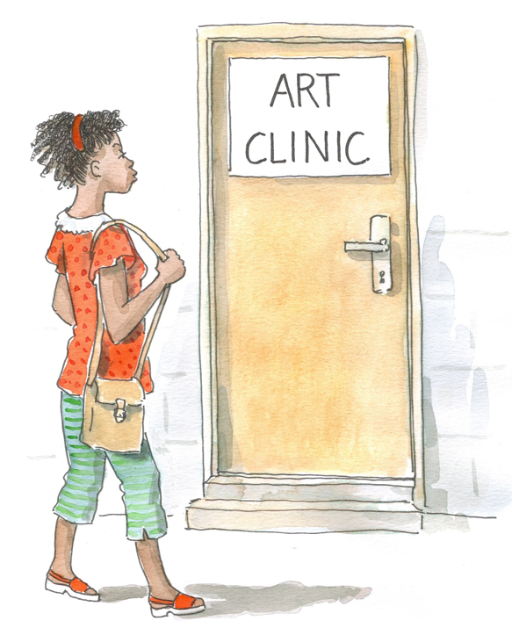
Welcome!
Please sign the registration sheet
Please make a name tag for yourself
Please take a notebook, pen, and a copy of the Participant Manual
Participant Manuals include all key information covered in this training.
  Follow along in your manual and take notes during the training.
  Keep your manual for future reference (after the training).

Slide 5
Session 1.1 Objective
After completing this session, participants will:
Know more about the trainers and other training participants, and will have discussed expectations for the training

Slide 6
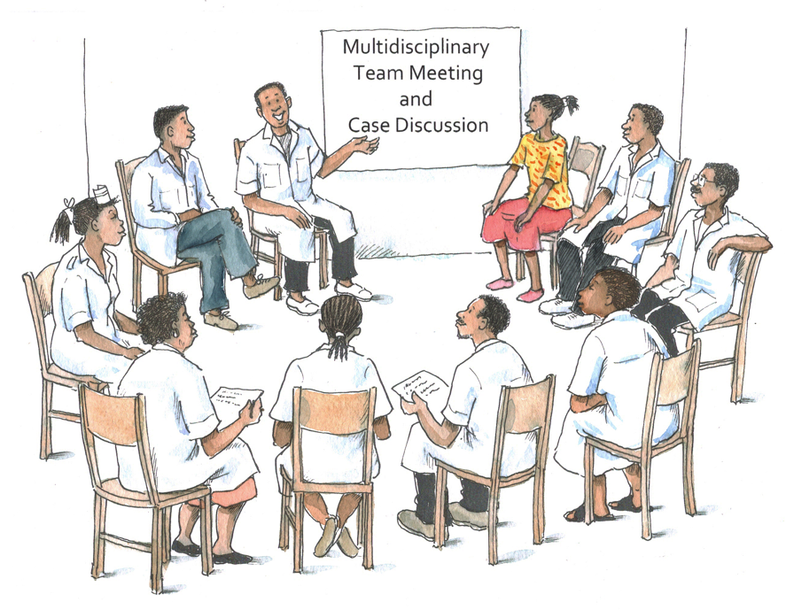
Exercise 1
Getting to Know Each Other: Large group discussion and individual reflection

Slide 7
Exercise 1: Introductions
Take 1 minute (and only 1 minute, please!) to:
  State your name and position
  Share 1 memorable experience from your own adolescence (good or bad)
Introduction of the adolescent co-trainer(s)

Slide 8
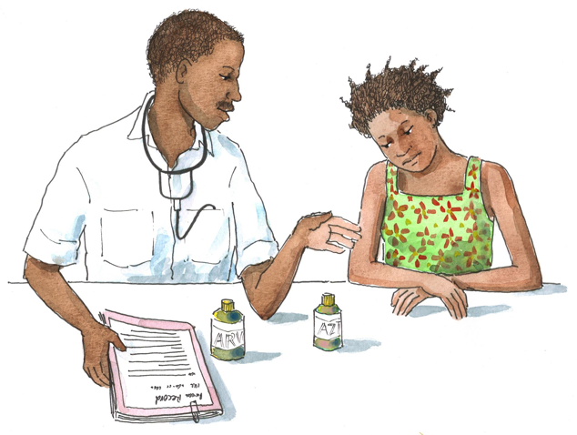
Exercise 1: Individual Reflection
Think about the following questions and write down your answers. These papers will not be collected, but please put them in a safe place to refer to later.
Strengths: What is 1 personal strength that helps you — or will help you — work effectively with adolescent clients?
Concerns: What concerns or worries do you have about providing care
to adolescents living with HIV?
Expectations: What do you hope to learn during this training course?

Slide 9
Exercise 1: Individual Reflection
It is important that you save the piece of paper with your strengths, concerns, and expectations written on them:
  You will need to refer to it again during Module 16
  Put it in-between the pages of your Participant Manual, somewhere in Module 16.

Slide 10
Questions or comments on this session?
10

Slide 11
Session 1.2
Training Objectives and Ground Rules

Slide 12
Session 1.2 Objectives
After completing this session, participants will:
Be able to explain the importance of a training specific to adolescent care and treatment
Understand the training objectives
Have set training “ground rules”

Slide 13
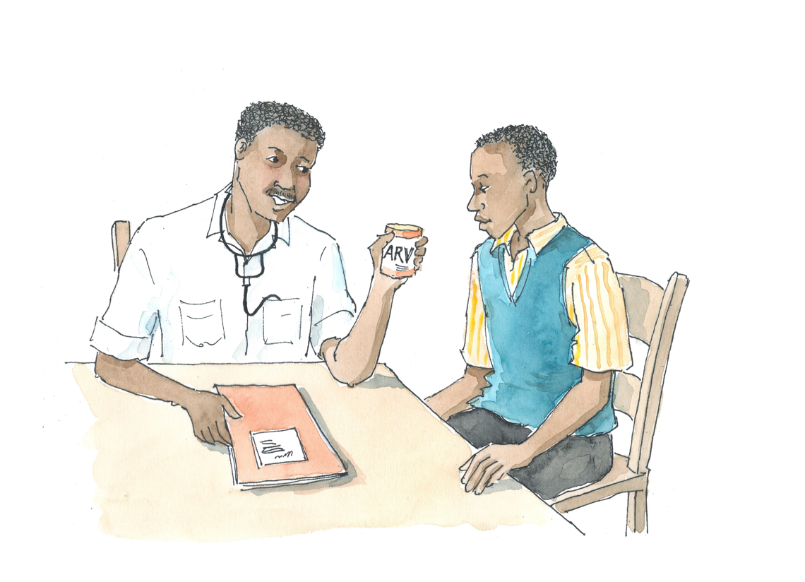
Discussion Questions
Why do you think a training specific to adolescent HIV care and treatment is important?

Slide 14
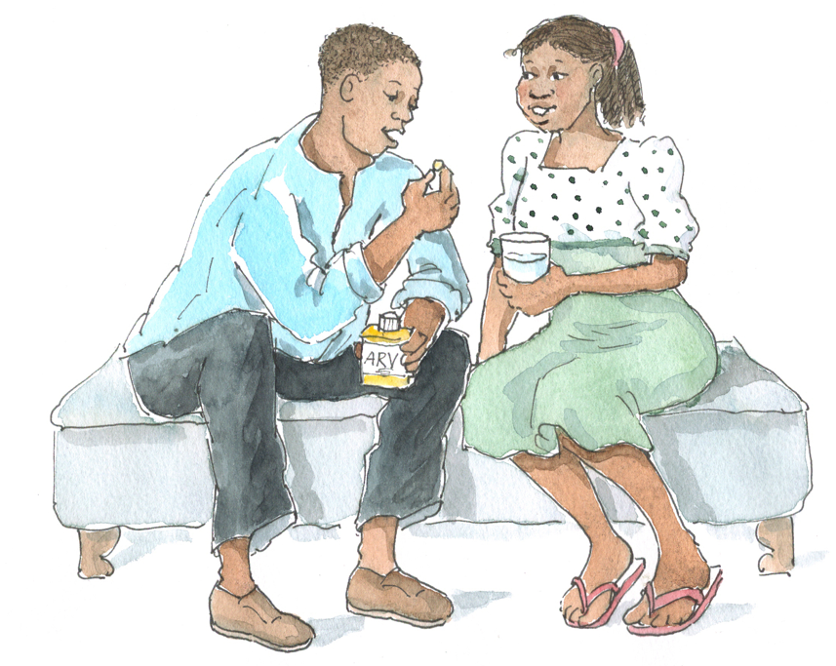
Key Facts about Adolescents and HIV
Global epidemiology:
In 2009, 41% of all new HIV infections (in people aged 15 and over) were among youth 15–24 years of age.
2 million adolescents aged 10–19 years are living with HIV (1.5 million of whom reside in sub-Saharan Africa).
Slightly more than half of all people living with HIV are women or girls. In sub-Saharan Africa, young women aged 15-24 years are 8 times more likely than men to be HIV positive.
Source: UNAIDS. (2010).

Slide 15
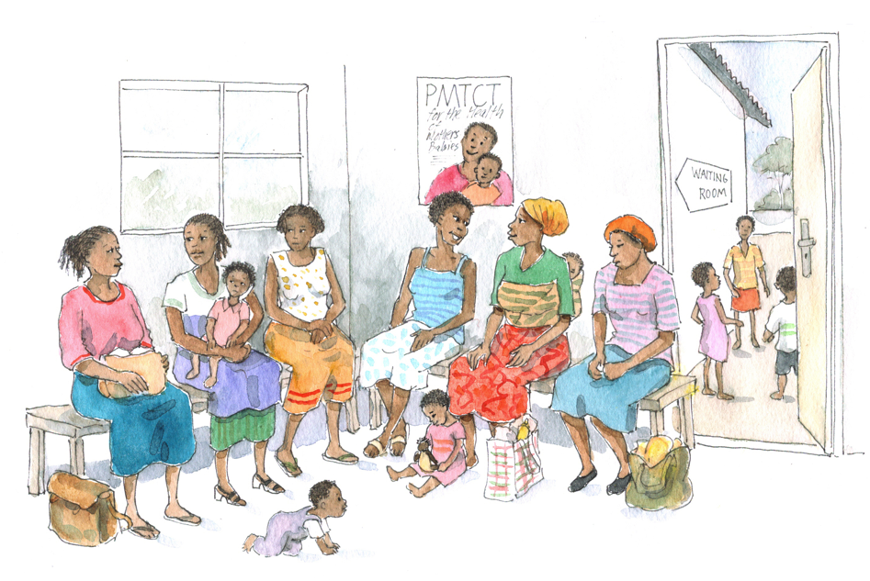
Key Facts about Adolescents and HIV
(Continued)
Globally, deaths among children under 15 years of age are declining.
  An estimated 260,000 children died from AIDS-related illnesses in 2009 — this is approximately 19% fewer deaths than occurred in 2004.
  This trend reflects the expansion of PMTCT and an increase in access to antiretroviral treatment for children.
Source: UNAIDS. (2010).

Slide 16
Key Facts about Adolescents and HIV
(Continued)
[Add national epidemiological statistics here]

Slide 17
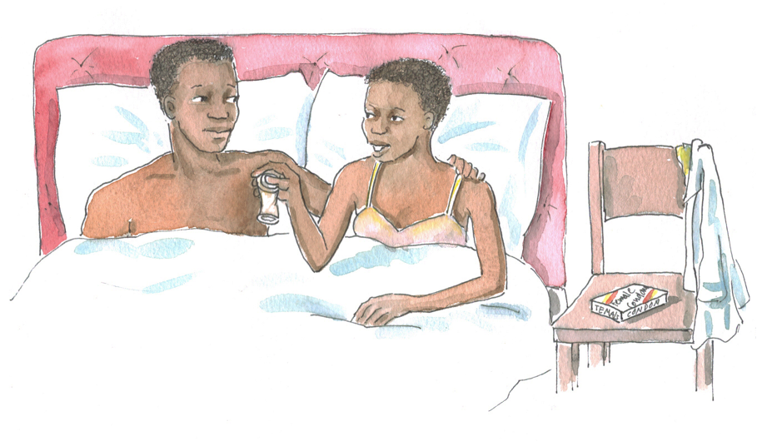
Key Facts about Adolescents and HIV
(Continued)
Global knowledge and behavior:
Among young people in 15 of the most severely affected countries, HIV prevalence has fallen by more than 25% as young people have:
  Adopted safer sexual practices, including increased condoms use
  Delayed sexual debut
  Reduced multiple partnerships
Source: UNAIDS. (2010).

Slide 18
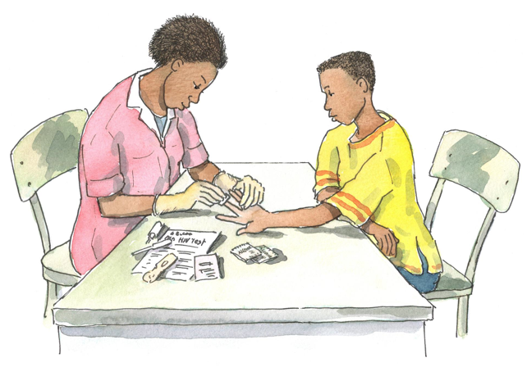
Key Facts about Adolescents and HIV
(Continued)
Less than half of young people living in 15 high HIV prevalence countries can correctly answer 5 basic questions about HIV and its transmission.
Young people living in the 25 countries with the highest HIV prevalence have shown gradually improving knowledge about HIV, but they still fall short of global targets and what is necessary to keep them safe.
Source: UNAIDS. (2010).

Slide 19
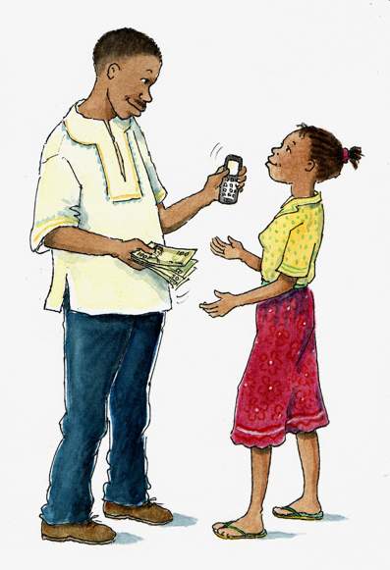
Why a Training on Adolescent HIV Care and Treatment?
Young people are at the center of the HIV epidemic. They are particularly vulnerable to HIV infection due to social, political, cultural, biological, and economic reasons.

Slide 20
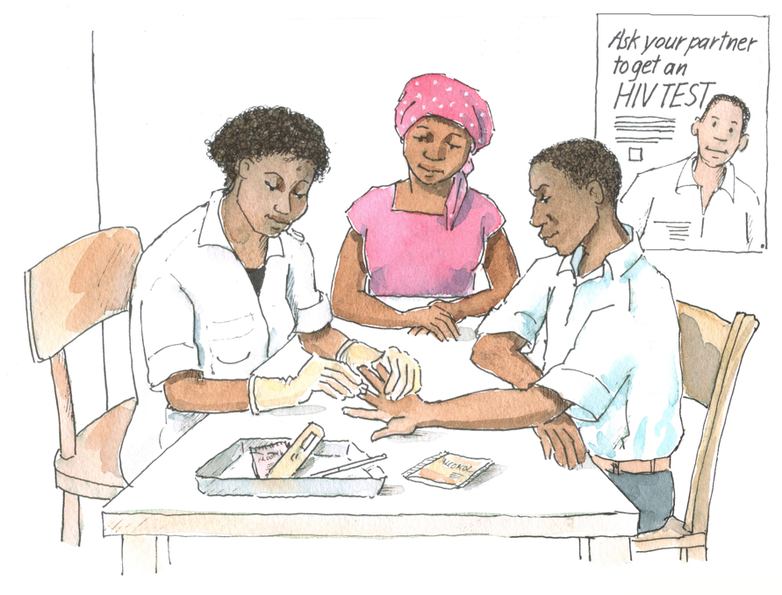
Why a Training on Adolescent HIV Care and Treatment? (Continued)
With increased access to pediatric HIV care and treatment, perinatally-infected children are living longer and reaching adolescence and adulthood.
More young people are being tested for HIV because of increased awareness, reduced stigma, greater access and acceptance of testing, etc. Also, more adolescents who are pregnant are being tested for HIV through PMTCT programs.
ALHIV face unique health, adherence, and psychosocial issues and challenges.

Slide 21
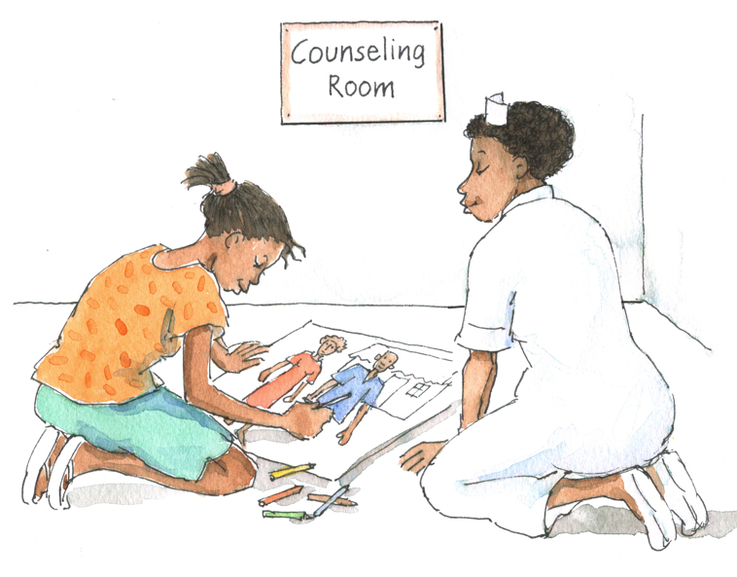
Why a Training on Adolescent HIV Care and Treatment? (Continued)
Programs and clinical services need to be youth-friendly to attract and retain adolescent clients.
There are successful models of adolescent HIV care and treatment services in many cities across high-, medium-, and low-prevalence countries. These models can be adapted and scaled-up nationally.
Health workers need the knowledge and skills to meet the specific needs of adolescent clients.
Young people are our future!

Slide 22
Adolescent HIV Care and Treatment Training Objectives
By the end of this training, participants will be able to:
Describe the stages and characteristics of adolescence and the unique needs and challenges of adolescent clients
Implement strategies to make HIV-related services youth-friendly
Define and implement the package of HIV-related care and treatment services for adolescents
Implement effective communication and counseling skills with adolescent clients
Conduct a psychosocial assessment and provide ongoing psychosocial support services to adolescent clients

Slide 23
Adolescent HIV Care and Treatment Training Objectives (Continued)
Describe the importance of mental health services for adolescent clients, recognize when a mental health problem may exist, and provide appropriate referrals and support
Recognize the signs of and screen for alcohol and substance use disorders among adolescents, and provide support and referrals
Provide developmentally-appropriate disclosure counseling and support to adolescents and, where appropriate, their caregivers
Provide developmentally-appropriate adherence preparation and ongoing adherence support to adolescent clients and caregivers

Slide 24
Adolescent HIV Care and Treatment Training Objectives (Continued)
Support adolescents to live positively with HIV
Conduct sexual risk screening and provide non-judgmental, comprehensive counseling on sexual and reproductive health to adolescent clients
Provide basic, non-judgmental contraceptive counseling and services to adolescent clients
Describe the key components of PMTCT services for adolescents and provide referrals and support along the continuum of PMTCT care
Describe ways to link adolescents with needed facility and community-based support services

Slide 25
Adolescent HIV Care and Treatment Training Objectives (Continued)
Describe and implement activities to meaningfully involve adolescent clients in clinical services, such as through adolescent peer education programs
Prepare and support adolescent clients throughout the transition to adult care
Describe how monitoring and evaluation can be used to support adolescent HIV program improvements
Demonstrate core competencies in adolescent HIV care and treatment services in a clinical setting
Develop a site-specific action plan for implementing adolescent HIV care and treatment services

Slide 26
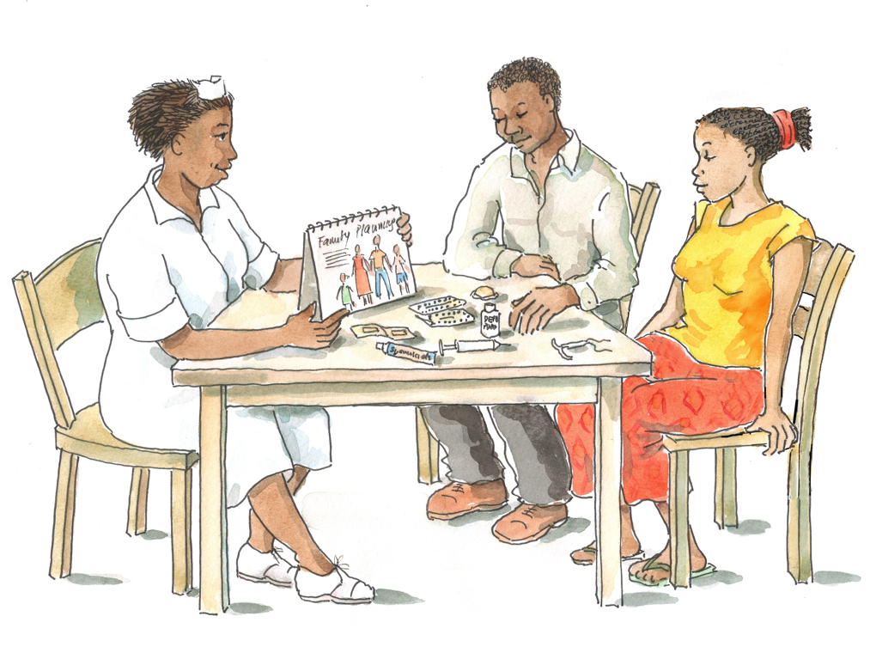
Adolescent HIV Care and Treatment Core Competencies
The core competencies are the skills that participants should have mastered by the end of the training.
Core competencies focus on specific skills, whereas objectives are sweeping statements that provide a summary of what is to be taught.
  There are 19 objectives for this course and approximately 60 competencies.
Now turn to Appendix 15B: Practicum Checklist (in Module 15) to review the core competencies for this course.

Slide 27
Training Syllabus and Agenda
The training includes 16 modules, each is divided into sessions:
Module 1: Introduction and Course Overview
Module 2: The Nature of Adolescence and the Provision of Youth-Friendly Services
Module 3: Clinical Care for Adolescents Living with HIV
Module 4: Communicating with and Counseling Adolescents
Module 5: Providing Psychosocial Support Services for Adolescents
Module 6: Adolescents, HIV, and Mental Illness
Module 7: Providing Disclosure Counseling and Support
Module 8: Supporting Adolescents’ Retention in and Adherence to HIV Care and Treatment

Slide 28
Training Syllabus and Agenda (Continued)
Module 9: Positive Living for Adolescents
Module 10: Sexual and Reproductive Health Services for Adolescents
Module 11: Family Planning and PMTCT Services for Adolescents
Module 12: Community Linkages and Adolescent Involvement
Module 13: Supporting the Transition to Adult Care
Module 14: Monitoring, Evaluation, and Quality Improvement
Module 15: Supervised Clinical Practicum
Module 16: Action Planning, Course Evaluation, and Closure
See Appendix 1A or the training agenda handed out by trainers.

Slide 29
Exercise 2
Setting Ground Rules and Introducing Daily Activities: Large group discussion
Ground Rules
“Anonymous Question Bowl”
“Morning Rounds”
Daily Evaluation – “How Did It Go?”

Slide 30
Exercise 2: Debriefing
What did we learn?
Key points:
  A comfortable and open environment will facilitate the group learning experience.
  Participants should feel free to speak to a trainer if they have any questions or concerns.
30

Slide 31
Questions or comments on this session?
31

Slide 32
Session 1.3:
Training Pre-Test

Slide 33
Session 1.3 Objective
After completing this session, participants will:
Have completed the training pre-test

Slide 34
Pre-Test
See Appendix 1B: Pre-Test.
Do not write your name. Think of a 3 or 4 digit number (for example, 011 or 1972) and write it on the top of your pre-test.
  Remember this number! (Write it on the inside front cover of your Participant Manual).
The pre-test is to find out what the group as a whole knows about adolescent HIV care and treatment. The results will help us plan the training.
You will take this same test again at the end of the training.
You have 20 minutes to complete the pre-test.

Slide 35
Pre-Test Debriefing
How did you feel about the pre-test questions?
Were they easy or difficult?
We will discuss the answers at the end of the training.
Remember: We are all here to learn and, by the end of the training, you will be able to answer all of these questions and many more!

Slide 36
Questions or comments on this session?
36

Slide 37
Session 1.4
Values Clarification

Slide 38
Session 1.4 Objective
After completing this session, participants will:
Have explored their own values and attitudes around adolescents and adolescent HIV care and treatment

Slide 39
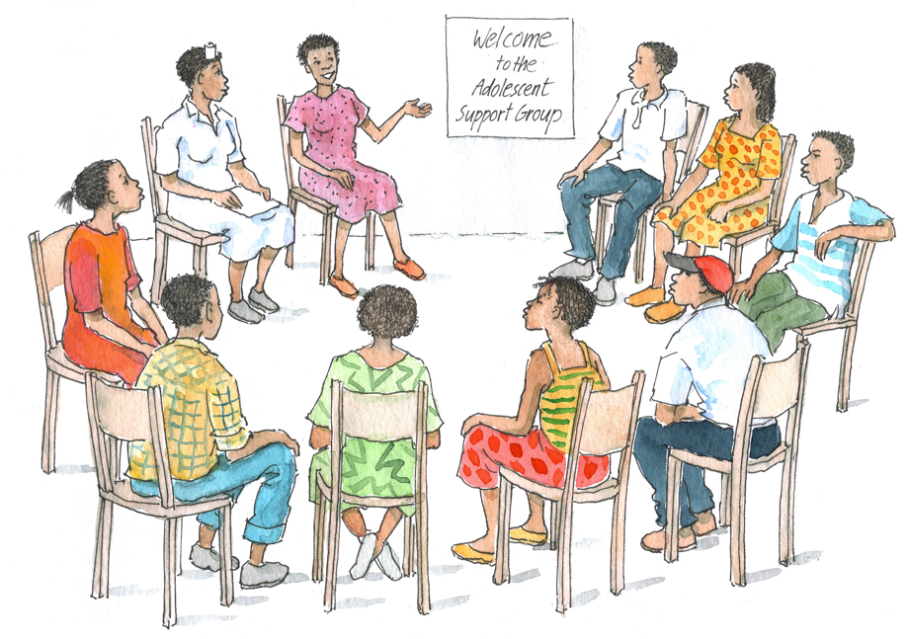
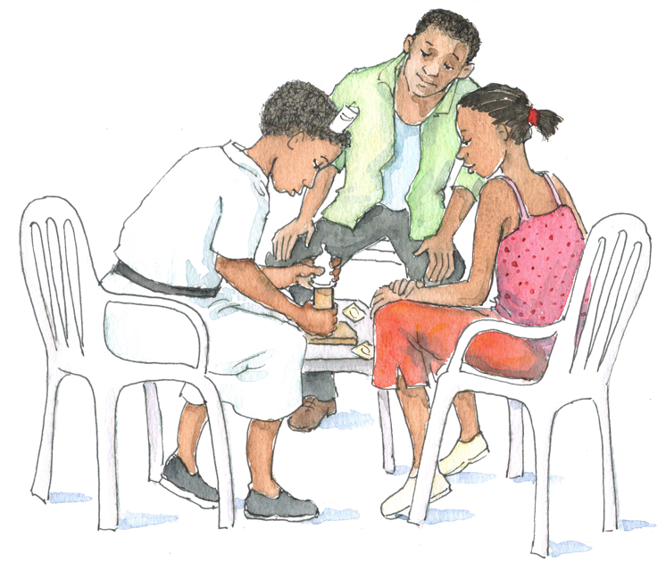
Exercise 3
Values Clarification: Large group exercise

Slide 40
Exercise 3: Debriefing
What did we learn?
Key points:
  Learn what you can about the culture, values, and attitudes of the clients with whom you work.
  Be sensitive to the culture, values, and attitudes of your clients, even if these are different from your own.
  Ensure you avoid prejudice and bias.
  Show clients that it is “safe” to receive care and to talk openly and honestly with you.
40

Slide 41
Questions or comments on this session?
41

