Slide 1
Adolescent HIV Care and Treatment
Module 2:
The Nature of Adolescence and the Provision of Youth-Friendly Services
Notes:
1

Slide 2
Module 2 Learning Objectives
After completing this module, participants will be able to:
Define adolescence
Identify some of the physical changes that occur during adolescence
Define the stages of adolescent development
Describe how ALHIV are different from children and adults living with HIV
Discuss the ways in which adolescents are a heterogeneous group

Slide 3
Module 2 Learning Objectives (Continued)
Discuss risk-taking as a normal part of adolescence as well as the consequence of negative risk-taking
Discuss some of the vulnerabilities faced by adolescents
Describe the characteristics of youth-friendly HIV care and treatment services

Slide 4
Session 2.1
Stages and Changes of Adolescence

Slide 5
Session 2.1 Objectives
After completing this session, participants will be able to:
Define adolescence
Identify some of the physical changes that occur during adolescence
Define the stages of adolescent development
Describe how ALHIV are different from children and adults living with HIV
Discuss the ways in which adolescents are a heterogeneous group

Slide 6
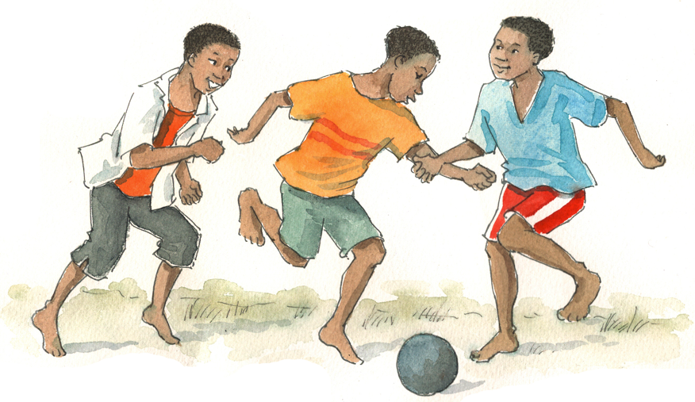
Brainstorming
What do we mean by the following terms?
Adolescents
Youth
Young people

Slide 7
Who Are We Talking About?
Adolescents are people between 10 and 19 years of age.
Adolescence is a phase of life that is defined differently across cultures.
Other commonly used terms are “youth” or “young people,” which have slightly different definitions:
Group | Age range (according to WHO)
Adolescents | 10–19 years
Youth | 15–24 years
Young People | 10–24 years
Focus of this training
Notes:
7
7

Slide 8
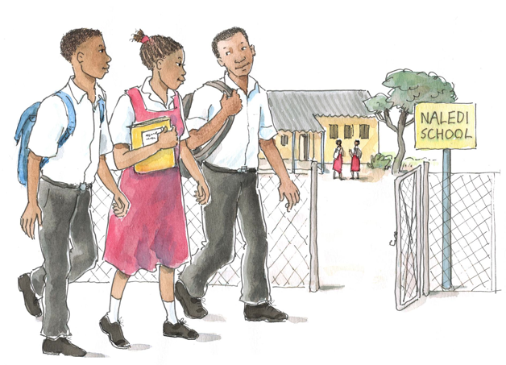
Discussion Questions
Think back to your own adolescence and also think about the adolescents you know in your life.
What are the key changes that occur during adolescence?
Physical and sexual changes
Social and emotional changes

Slide 9
Key Changes During Adolescence
Many physical and sexual changes occur during adolescence:
In females: | In males:
Development of breasts Appearance of pubic and underarm hair Widening of the hips Menarche Development of the vulva and pelvis | Growth of the penis, scrotum, and testicles Appearance of pubic, underarm, chest, and leg hair Night-time ejaculation Morning erection Development of back muscles
Notes:
9
9

Slide 10
Key Changes During Adolescence (Continued)
In both females and males:
Accelerated growth Increased perspiration The presence of acne Face has characteristics of young adult | Change in tone of voice Sexual desire activated Initiation of sexual activities
The system used most frequently to categorize these physical and sexual changes in girls and boys is referred to as the “Tanner staging system” (see Appendix 2A).
Notes:
10
10

Slide 11
Key Changes During Adolescence (Continued)
Adolescents also experience psychological and emotional changes:
Mood swings Insecurities, fears, and doubts Behavioural expressions of emotion, which may include withdrawal, hostility, impulsiveness, non-cooperation Self-centeredness Feelings of being misunderstood and/or rejected | Fluctuating self-esteem Interest in physical changes, sex, and sexuality Concern about body image Concern about sexual identity, decision-making, and reputation A need to feel autonomous and independent
Notes:
11
11

Slide 12
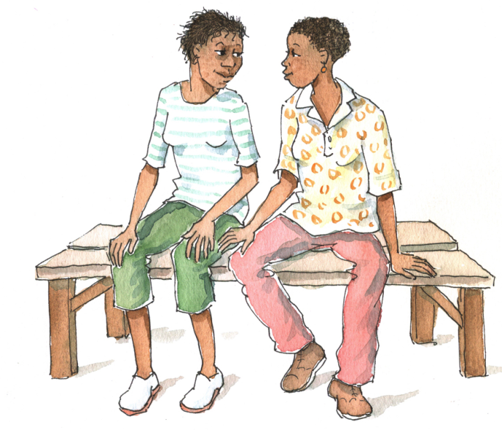
Remember:
Adolescents undergo rapid growth and development, resulting in both physical changes and changes in thinking, social skills, problem solving, and relationships.
These changes influence how adolescents interact, behave, and process information.
12

Slide 13
Stages of Adolescent Development
Key points:
Adolescence can be categorized into 3 overlapping developmental stages: early, middle, and late.
The ages given are approximate; maturation is more important than specific ages.
Maturation occurs in fits and starts.
Growth in each category of change can occur at different rates.
HIV impacts maturation in many ways.
See Table 2.2.

Slide 14
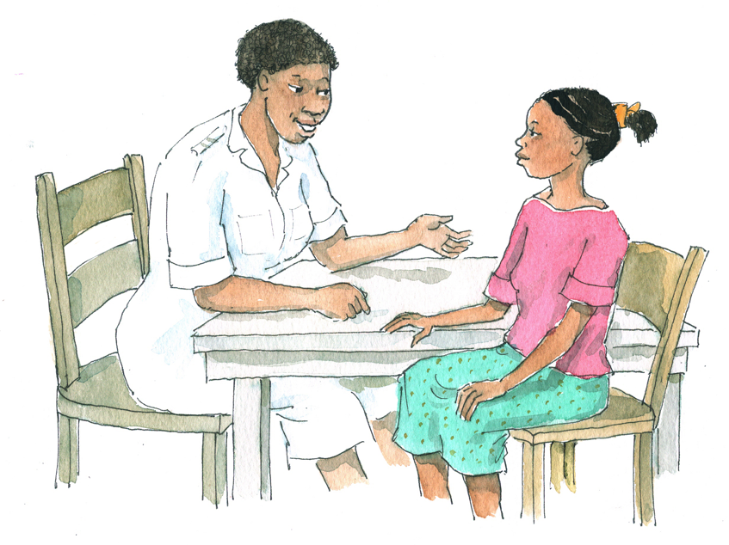
Discussion Question
How can perinatally-acquired HIV affect normal growth and development during adolescence?

Slide 15
Effects of HIV Infection – Growth
HIV affects growth in adolescents who are perinatally infected with HIV.
HIV does not affect the growth of adolescents infected after they have reached their adult height.
Even in perinatally infected children, the physical effects of HIV may be minimized through the use of effective ART.

Slide 16
Effects of HIV Infection – Growth (Continued)
If HIV is advanced, an adolescent may experience delays in physical development, including puberty. As a result, ALHIV may appear younger and smaller.
Small stature may lead to a negative self-image and may also affect how other people view the adolescent.
ALHIV may experience drug-related side effects, including those that change physical appearance.

Slide 17
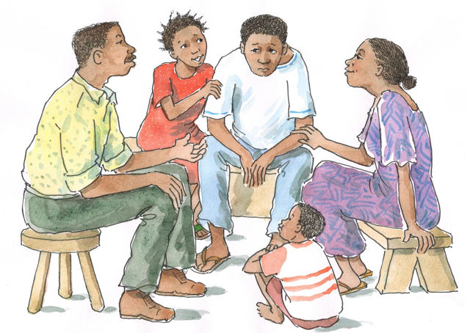
Effects of HIV Infection – Cognition
Adolescents perinatally infected with HIV may experience neurological consequences of longstanding HIV infection. The result may be developmental delays and learning problems.

Slide 18
Effects of HIV Infection – Psychological and Social
ALHIV are very likely to experience emotional difficulties. These difficulties may not necessarily be due to health status, but rather to the pressures of life and a history of loss (including the loss of parents and home).
Due to illness, ALHIV may miss out on activities that help define adolescents’ identities.
HIV can bring with it concerns that may affect ALHIV’s mental health and their sense of fitting in with peers.
Many ALHIV live with either one or neither birth parent. → ALHIV may not feel like they are a part of their adopted home, which can lead to a sense of isolation.

Slide 19
Effects of HIV Infection – Peers
ALHIV may experience peer problems, which can be exacerbated by the stigma associated with HIV.
ALHIV may have to regularly miss school to attend clinic appointments. This may impact upon their educational attainment and their sense of fitting in with peers.
In some places, few ALHIV attend school, which suggests that the school environment is not supportive of ALHIV’s needs.
If adolescents feel different from their peers, they have a harder time bonding with them. This can also make separation from caregivers more difficult.

Slide 20
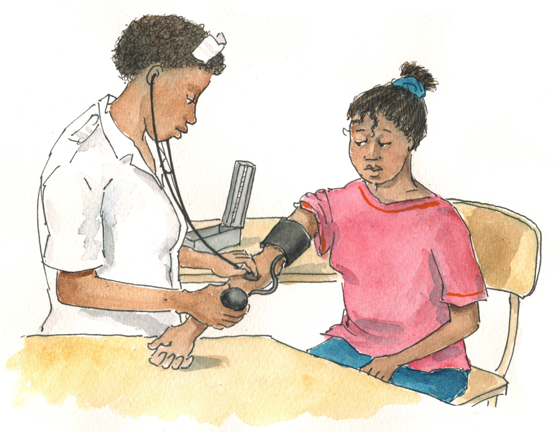
Discussion Question
What do we mean by the phrase, “not big children, not little adults?”
What are some of the key characteristics that distinguish adolescents from children and adults?
What might be the implications of each characteristic for ALHIV services?

Slide 21
No Longer Children, Not Yet Adults
Distinguishing characteristics of adolescents may include:
Energetic, open, spontaneous, inquisitive
Unreliable and/or irresponsible
Moody
Desire independence
Influenced by friends
Less influenced by family
Looking for role models (often outside the family)
Embarrassed to talk to adults about personal issues
Desire to be different from parents and previous generation in general
These characteristics are generalizations — they are not all applicable to every adolescent client.

Slide 22
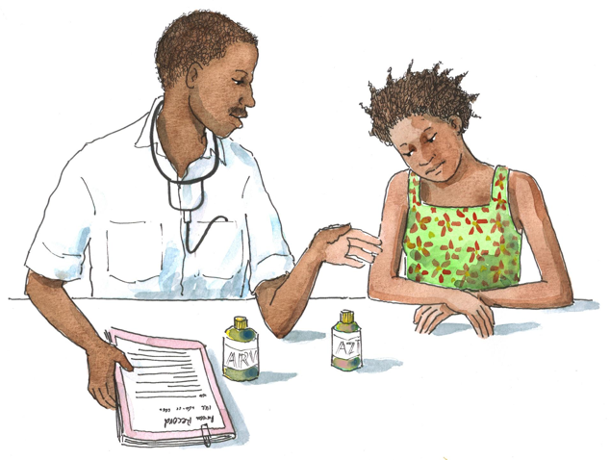
Exercise 1
Adolescents: Not Big Children, Not Little Adults: Small group work and large group discussion

Slide 23
Exercise 1: Small Group Work
What are some of the special characteristics of adolescents that health workers need to consider when providing them with HIV care and treatment?
How do the needs of adolescent clients differ from those of pediatric and adult clients?
Adolescents are a heterogeneous/diverse group. What are some of the differences health workers may see among different adolescents clients? What are the implications of these differences for their HIV care?

Slide 24
Exercise 1: Debriefing
What did we learn?
Key points:
The care, treatment, and support provided to an adolescent client needs to be tailored to that adolescent’s maturity level, social situation, and level of understanding.
ALHIV differ from both children and adults living with HIV because of the rapid changes that occur during adolescence.
Adolescents are a heterogeneous group — not only do they differ from each other, but each individual adolescent also changes as he or she matures.
Health workers need to understand these differences and consider them when providing care to ALHIV.

Slide 25
Special Considerations for Adolescent Clients
Adherence to medicines:
Younger adolescents may still rely on a caregiver to take their medicines.
Older adolescents need to take some or all of the responsibility for taking their medicines every day.
Often, adolescents struggle with adherence ad various points in their development, as they strive to form their own identity and to fit in with peers.

Slide 26
Special Considerations (Continued)
Adherence to care:
Adherence to care may be more difficult for ALHIV because:
Often have less disciplined or structured lives and less stable relationships outside of the family
Are more likely to lack skills to negotiate health services and to understand side effects, treatment options, and regimen requirements
Outreach is more difficult because adolescents are scattered and it is harder to bring them into care.
Adolescents can become lost in the system when in transition from pediatric to adult HIV services.

Slide 27
Special Considerations (Continued)
Stigma and discrimination:
Blame is often placed on ALHIV because of an assumption that they voluntarily engaged in “risky behavior.”
Stigma and discrimination associated with HIV prevents many ALHIV from disclosing their HIV-status.
This may be a particular issue when adolescents decide to become involved in a sexual relationship.

Slide 28
Special Considerations (Continued)
Counseling adolescents:
Adolescents’ cognitive abilities and skills are different from adults
They require different counseling approaches and often more extensive and intensive counseling sessions.
Conflicts between cultural or parental expectations and adolescents’ emerging values can present serious challenges.
Adolescent clients often depend on their caregivers and cannot always make independent decisions.
Adolescents have a range of future decisions to make, like whether to have children, whether to get married, etc.
Adolescents face strong peer pressure and tend to be dependent on peers for lifestyle guidance.

Slide 29
Special Considerations (Continued)
Safer Sex:
ALHIV may not understand risk-taking behavior or the importance of risk reduction. This makes them more vulnerable to unintended pregnancy and STIs
There is a widespread belief that ALHIV are “not supposed” to be having sex. As a result, they often hide their sexuality.
Adolescents may have limited access to contraceptives; they may also lack the skills to use them correctly and/or negotiate their use.
Gender inequality may further reduce female adolescents’ ability to negotiate condom use.

Slide 30
How Adolescents Differ from One Another
Adolescents are a heterogeneous group and may differ from one another in many ways:
Stage of development
Gender
Sexual orientation
Home or family situation
Educational level
Financial situation
Geographic location
Relationship or marital status
Experience with stigma and discrimination
Counseling and education should meet the unique needs of each adolescent.

Slide 31
Questions or comments on this session?

Slide 32
Session 2.2
Adolescent Vulnerabilities, Risk-Taking Behaviors, and Their Consequences

Slide 33
Session 2.2 Objectives
After completing this session, participants will be able to:
Discuss risk-taking as a normal part of adolescence as well as the consequences of negative risk-taking
Discuss some of the vulnerabilities faced by adolescents
Notes:
33
33

Slide 34
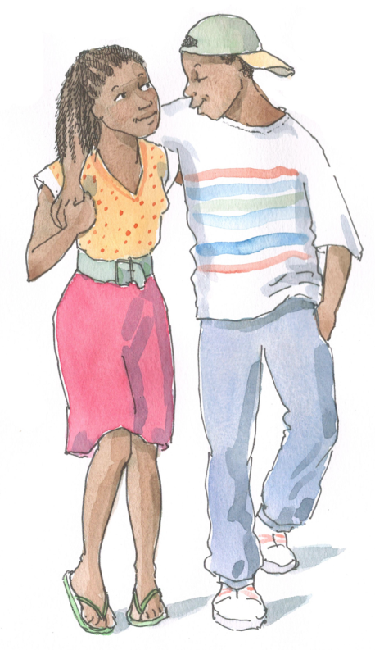
Discussion Questions
What risks did you take when you were an adolescent?
Thinking back, why do you think you took these risks?

Slide 35
Risk-Taking As a Normal Part of Growing up
Adolescents take risks as a normal part of growing up. Risk-taking is the tool adolescents use to define and develop their identity. Healthy risk-taking is a valuable experience.
Healthy risk-taking includes participating in sports, developing artistic and creative abilities, traveling, making new friends, and contributing constructively to one’s family or community.

Slide 36
Risk-Taking As a Normal Part of Growing up (Continued)
Curiosity, sexual maturity, a natural inclination toward experimentation, and peer pressure can lead to unhealthy/ negative risk-taking. This includes:
A sense of powerfulness, feelings of invulnerability, and impulsiveness can lead to a lack of future planning.
Risk-taking can be caused by a lack of knowledge.
In some cultures, young men are encouraged to take risks as a way of proving their masculinity.
Drinking, smoking, using drugs
Driving recklessly
Unsafe sexual activity
Self-mutilation
Running away
Stealing
36

Slide 37
Risk-Taking – Health Workers Should:
Encourage and help adolescent to find healthy risks.
Help adolescents evaluate risks, anticipate consequences, and develop strategies for diverting energy into healthier activities when necessary.
Share lessons learned from their own histories of risk-taking and experimenting.
Advise adolescents to seek additional help if they are experiencing psychological problems, having problems at school, or engaging in illegal activities.

Slide 38
Types and Consequences of Unhealthy Risk-Taking Behavior
Unhealthy risk-taking can result in:
Poor adherence to ARVs or HIV care and treatment
Unprotected sex
Experimentation with alcohol, marijuana, etc.
Can interfere with judgment and adherence
Can suppress the immune system; can make a person more vulnerable to OIs; can compromise body’s response to AZT
Can adversely interact with HIV medications, causing illness
Can reduce inhibitions and affect decision-making
In a Botswana study, heavy drinking was associated with unsafe sex, sex with multiple partners, paying for sex, and intergenerational sex.

Slide 39
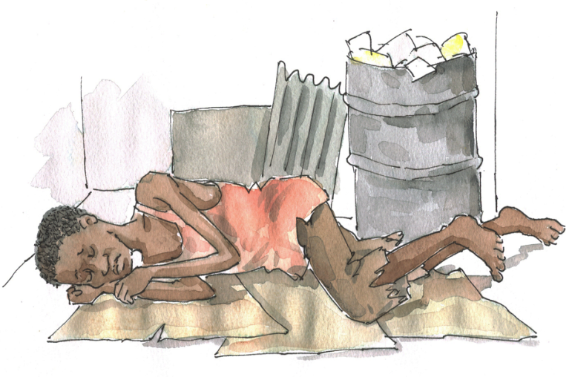
Brainstorming
What do we mean when we say adolescents are vulnerable? Vulnerable to what?
What makes adolescents, and in particular ALHIV, vulnerable to poor health? What makes them emotionally vulnerable? What makes them economically vulnerable?
What specifically makes adolescent girls vulnerable? Adolescent boys?

Slide 40
Physical Vulnerabilities
Young people, particularly young women, are more vulnerable to STIs than adults.
The cells lining the inside of the normal adolescent cervical canal are more vulnerable to infections than the cells that line the mature cervical canal of adults.
ALHIV, like all PLHIV, are particularly vulnerable to nutritional and caloric deficiencies, due to the increased energy demands HIV imposes on the body.
HIV can contribute to compromised physical and psychological development, including stunting and slower than normal growth

Slide 41
Social, Psychological, and Emotional Vulnerabilities
Psychological factors that put many adolescents at increased risk of physical harm include a general sense of invulnerability, the desire to try new things, and a willingness to take risks.
Adolescents’ family situations may offer little social and material/financial support.
Mental health problems can increase during adolescence.
Adolescents often lack maturity, assertiveness, and good communication skills → difficulty making good decisions, articulating needs, and withstanding peer pressure
There are often unequal power dynamics between adolescents and adults; adolescents are more vulnerable to abuse.

Slide 42
Socioeconomic Vulnerabilities
The need for money often increases during adolescence:
Lack of access to money or employment can lead adolescents to steal or take work in hazardous situations.
Economic hardship can increase health risks.
Adolescents are more likely to experiment with drugs and alcohol, and disadvantaged adolescents are at greater risk of substance abuse.
Young women are particularly vulnerable:
They often face gender discrimination that affects food allocation, access to health care, adherence to care, the ability to negotiate safer sex, and opportunities for social and economic well being.
Some marry very young to escape poverty.
Many adolescents are at risk due to other socioeconomic and political reasons.

Slide 43
Questions or comments on this session?

Slide 44
Session 2.3
Providing Youth-Friendly Services to Adolescents

Slide 45
Session 2.3 Objective
After completing this session, participants will be able to:
Describe the characteristics of youth-friendly HIV care and treatment services
Notes:
45
45

Slide 46
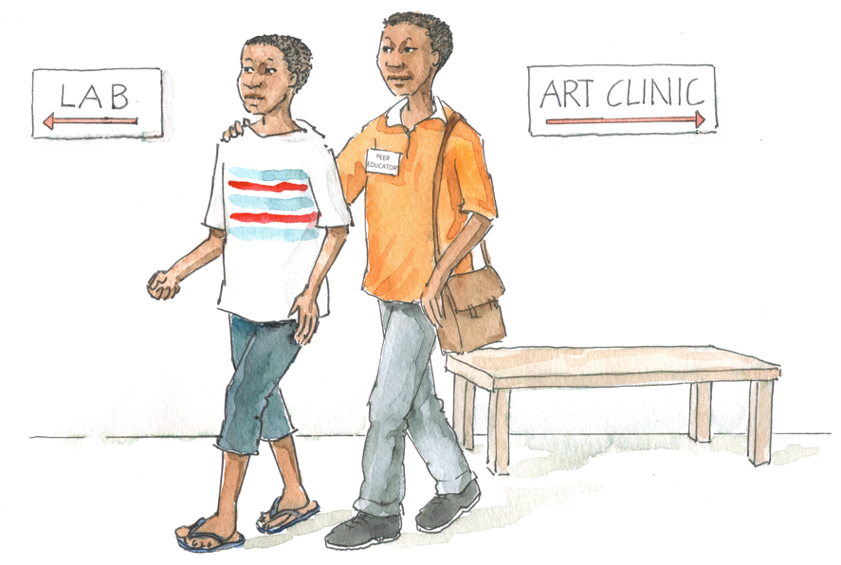
Brainstorm
What do we mean by “youth-friendly services?”

Slide 47
Characteristics of Youth-Friendly Services
In order to serve adolescent clients with HIV prevention, care, treatment, and support, and related health services, clinics and programs must be able to attract, meet the needs of, and retain these clients.

Slide 48
Characteristics of Youth-Friendly Services (Continued)
See Table 2.3.
Health worker characteristics:
Specially trained/oriented staff All staff display respect for youth All staff maintain privacy and confidentiality Enough time for health worker-client interaction

Slide 49
Characteristics of Youth-Friendly Services (Continued)
Health facility characteristics:
Separate space for young people Special times when young people can receive services Convenient hours Convenient location Adequate space and privacy Comfortable, youth-friendly surroundings Peer Educators available

Slide 50
Characteristics of Youth-Friendly Services (Continued)
Program design characteristics:
Youth involvement in program design and monitoring Drop-in clients welcomed Short waiting times Set up to provide chronic disease management Appointment and tracking systems in place Affordable or free services Publicity materials that inform and reassure | Friendly to male and female clients “1-stop shopping” Referrals to clinical and community-based services Youth-friendly educational materials available to take away Youth support groups Peer Educators available
Source: Senderowitz, J., Solter, C., & Hainsworth, G. (2004). Comprehensive reproductive health and family planning training curriculum. 16: Reproductive health services for adolescents. Watertown, MA: Pathfinder International.

Slide 51
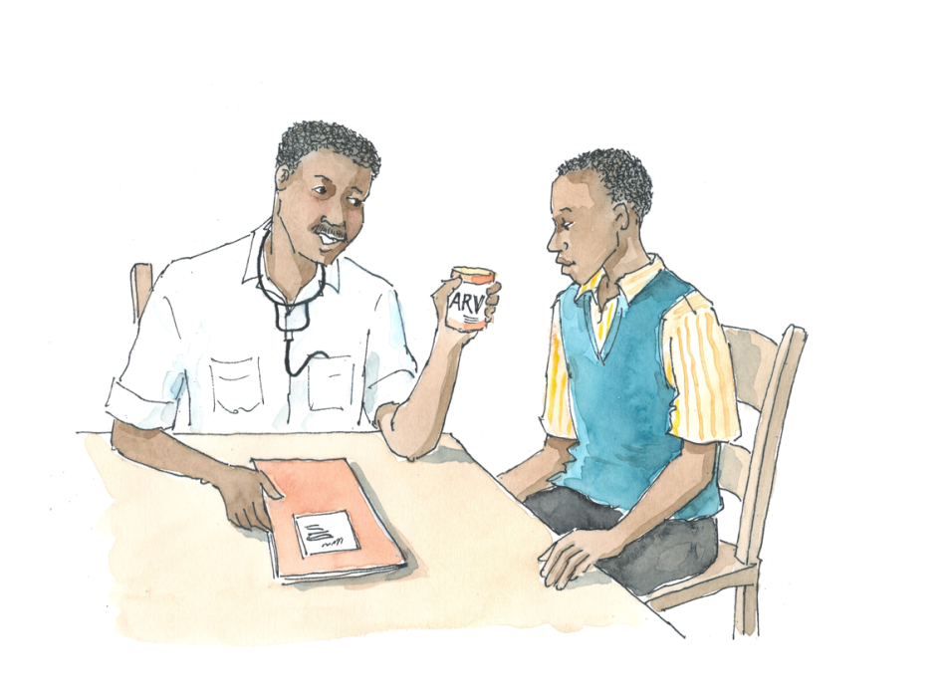
Brainstorming
What steps might you take to make existing clinical services in your own setting friendlier to ALHIV?

Slide 52
Organizing Youth-Friendly Services
Many things can be done to improve the youth-friendliness of comprehensive HIV care and treatment services.
It is important that we first assess where we are with adolescent services so we can effectively plan the way forward.
Sometimes even the smallest adjustments or changes can help — without creating additional workload or incurring any additional costs.
A step-by-step guide to make services more youth-friendly is provided in Table 2.4.

Slide 53
Making Services More Youth-Friendly
Assess clinic needs: figure out what needs to be done to make services more youth-friendly
Conduct assessment using tool like the one in Appendix 2B: Checklist and Assessment Tool for Youth-Friendly HIV Care and Treatment Services. See Appendix 2C for a sample client satisfaction survey for youth.

Slide 54
Making Services More Youth-Friendly
(Continued)
Design an action plan that will respond to the needs identified in the assessment: list the most important activities first and, for each activity, include a timeline and list the person responsible
Identify the needed human and material resources
Present the action plan to stakeholders
Implement, monitor, and evaluate the planned activities

Slide 55
Exercise 2
Making Services Youth-Friendly: Small group work and large group discussion
See Appendix 2B: Checklist and Assessment Tool for Youth-Friendly HIV Care and Treatment Services.

Slide 56
Exercise 2: Debriefing
What did we learn?
Key points:
When working to make services friendlier to ALHIV, we must first assess where we currently are so we can decide the improvements that need to be made.
One way of doing this is by using an assessment tool.
We will discuss this more in Module 16, when we develop an action plan for our facilities.
Keep your notes from this Exercise so that you can refer to them later in the training!

Slide 57
Questions or comments on this session?

Slide 58
Module 2: Key Points
Adolescence, the years between the ages of 10 and 19, is characterized by rapid growth and development as well as psychological and emotional changes.
During adolescence, social relationships move from being family-centered to being more peer- and community-centered. It is also a time when new skills and knowledge are acquired and new attitudes are formed.

Slide 59
Module 2: Key Points (Continued)
ALHIV may experience adolescence differently. Most notably, long-standing HIV infection and/or advanced HIV disease may affect ALHIV’s expected physical and emotional development. Social development may be atypical as well.
As part of growing up, adolescents take risks. Risk-taking is the tool adolescents use to define and develop their identities. Healthy risk-taking is a valuable experience.
Unhealthy risk-taking, however, can sometimes have lifelong consequences. For ALHIV, this may include poor adherence to medications, the discontinuation of care, or sexual risk-taking, which can lead to the further spread of HIV.

Slide 60
Module 2: Key Points (Continued)
Health workers should remember the reasons that clients may be vulnerable as well as the ways these vulnerabilities relate to risk-taking behavior and their participation in and adherence to HIV care and treatment. An understanding of their adolescent clients’ lives can help health workers work with ALHIV to transition safely into adulthood.
In order to serve adolescent clients with HIV-related health services, clinics and programs must be able to attract, meet the needs of, and retain these clients.

