Slide 1
Adolescent HIV Care and Treatment
Module 8:
Supporting Adolescents’ Retention in and Adherence to HIV Care and Treatment

Slide 2
Module 8 Learning Objectives
After completing this module, participants will be able to:
Define retention in and adherence to HIV care and treatment
Identify common barriers to retention in care and adherence to treatment among adolescent clients
Discuss ways that health workers and health facilities can support ALHIV’s retention in and adherence to care
Conduct adherence preparation sessions with ALHIV and their caregivers

Slide 3
Module 8 Learning Objectives (Continued)
Use tools to provide adherence counseling and to help clients and caregivers make a personal adherence plan
Assess adolescent clients’ (and caregivers) adherence
Provide ongoing, age-appropriate support to improve adolescent clients’ (and caregivers’) adherence

Slide 4
Session 8.1
Introduction to Retention and Adherence

Slide 5
Session 8.1 Objectives
After completing this session, participants will be able to:
Define retention in and adherence to HIV care and treatment
Identify common barriers to retention in care and adherence to treatment among adolescent clients

Slide 6
Overview of Retention and Adherence
Retention:
Definition: Keeping (“retaining”) clients in HIV care and treatment
A goal of all HIV care and treatment programs is to retain clients in care and treatment.
For ALHIV, supporting retention also means supporting their transition to adult care and treatment.
Adherence:
Definition: How faithfully a person sticks to and participates in his or her HIV prevention, care, and treatment plan
Includes active participation of the client (and caregiver)
Includes adherence to both medications and care
Depends on a shared decision-making process
Determines the success of HIV programs
Changes over time

Slide 7
Adherence to Care Includes:
Entering into and continuing lifelong care and treatment
Attending appointments and tests as scheduled
Taking medicines to prevent and treat OIs
Participating in ongoing health education and counseling
Picking up medications when scheduled and before running out
Recognizing problems and coming to the clinic for care
Adopting a healthy lifestyle and trying to avoid risky behaviors

Slide 8
Adherence to Treatment Includes:
Taking ART correctly, as prescribed, for a person’s whole life — even if he or she feels healthy
Taking other medicines, such as CTX, as prescribed
Not taking any “treatment breaks”
In the context of ART, studies have shown that clients must take over 95% of their necessary doses to achieve the conditions for therapeutic success.

Slide 9
Non-Adherence Includes:
Missing one or many appointments
Not following the care plan
Missing a dose or doses of medicine
Sharing medicines with other people
Stopping medicine for a day or many days
Taking medicines at the wrong times
Taking medicines without following instructions about timing or food intake
Non-adherence to treatment can lead to drug resistance, preventing ART from working and causing people to get very sick.

Slide 10
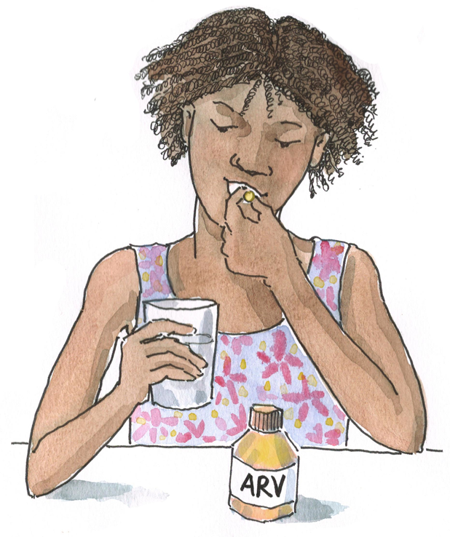
Discussion Question:
Why is excellent adherence to care and treatment important for ALHIV?

Slide 11
Why is Excellent Adherence Important?
To ensure that medicines do their job (increase CD4 count, decrease amount of HIV in the body, prevent OIs, etc.)
To make sure people get all the benefits of ART (feeling better, not getting sick as often, living longer)
To reduce the risk of spreading the virus to others (“altruistic adherence”)
To help ALHIV grow and develop into healthy adults
To keep people looking and feeling good so they can get back to “normal” life
So the virus does not become resistant to certain medicines

Slide 12
Remember:
Retention and adherence are closely related. Health workers and health systems play an important role in retaining clients in care. Adherence support should be ongoing — not one-time events — and the entire multidisciplinary team is responsible for providing these services. No one is perfect. It is important not to judge adolescent clients (or caregivers) if they are non-adherent. Instead, we should try to understand why they do not adhere and help find ways to resume good adherence as soon as possible.

Slide 13
Discussion Questions
What are the most common retention and adherence issues for ALHIV?
What are the most common factors affecting retention and adherence among younger adolescents?
How about among older adolescents?

Slide 14
Health Service Factors Affecting Adherence
Youth-friendliness of services
Level of confidentiality
Provider attitudes
Existence of drug stock-outs
Distance/transportation costs
Convenience of clinic hours
Patient record and tracking systems
Number and type of health workers
Provider language abilities
Length of waiting times
Space for private counseling
Level of staff turnover
Linkages between services
Referral systems
Existence of support groups
Level of PLHIV involvement
Cost of health services or medicines

Slide 15
Individual Factors Affecting Adherence
Rebellion or risk- taking
Desire to fit in with peers
Feeling self-conscious about taking medication
Forgetting to take one’s medicine
Side effects
Forgetting to go to the pharmacy/running out of tablets
Having difficulty accepting one’s HIV-status
Stigma and discrimination
Disclosure
Family or social support
How sick or well person feels
Migration or relocation affecting continuity of care
Whether person can take time away from home, school, or work to go to clinic appointments
Having a mental illness

Slide 16
Community and Cultural Factors Affecting Adherence
Family and social support
Poverty
Lack of food
Stigma and discrimination
Caregiver’s availability, health, and understanding of adherence
Societal discomfort with youth and related issues, such as sexuality
Extent of disclosure
Inability to find child care
Inability to take time off from school or work for clinic visits
Gender inequality
Violence
Distrust of the clinic/hospital
Use of traditional medicine
Political instability or war
Physical environment

Slide 17
Medication Factors Affecting Adherence
Side effects
Changing pediatric doses
Changing regimens
Number of pills in regimen
Dose timing
Availability of reminder cues — pill boxes, calendars, alarms, etc.
Taste
Changes in drug supplier — labeling, pill size, color, formulation, etc.

Slide 18
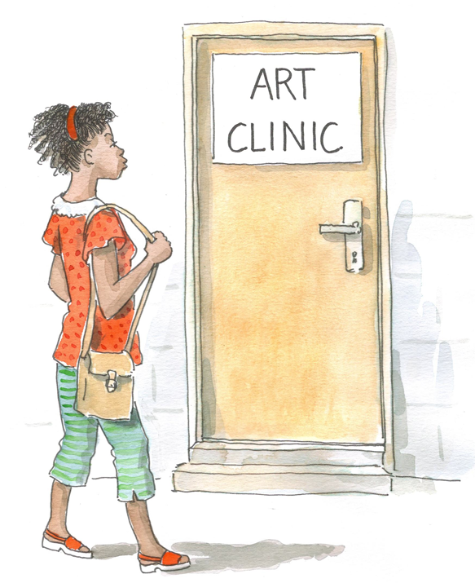
Discussion Question
Which of these issues do you think has the greatest impact on an adolescent’s retention and adherence? Why?

Slide 19
Remember:
There are many challenges to adherence among ALHIV:
They engage in more risk-taking behaviors.
They have a desire to “fit in” with peers and appear “normal.”
They may not take their medication as a way of demonstrating defiance or because of a need to define their identity.
We often blame clients for not adhering to care and treatment, but not having access to quality, youth-friendly health services is often one of their biggest barriers to retention and adherence.

Slide 20
Questions or comments on this session?

Slide 21
Session 8.2
Supporting Retention and Adherence to Care

Slide 22
Session 8.2: Objective
After completing this session, participants will be able to:
Discuss ways that health workers and health facilities can support ALHIVs’ retention in and adherence to care

Slide 23
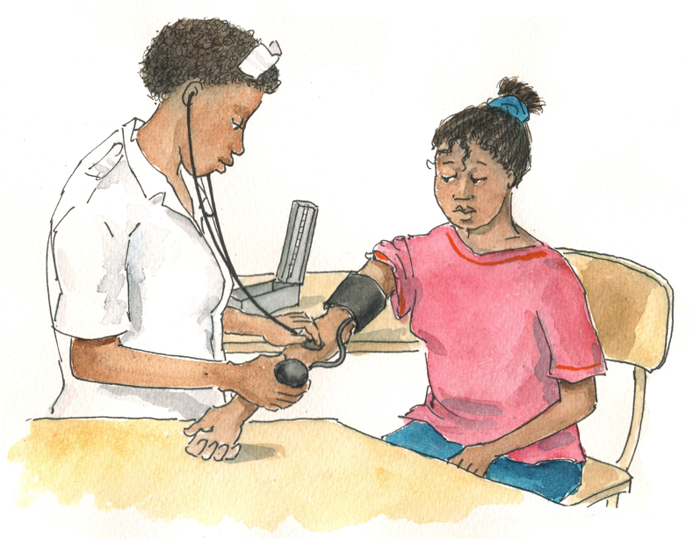
Brainstorming
We are not always able to address ALL of a client’s barriers to adherence, but there are many factors that we CAN address to support retention and adherence.
What are some of the ways that health workers can minimize barriers to retention and adherence to care?

Slide 24
Improving Retention in and Adherence to Care
Ensure services are youth-friendly and convenient.
Use a developmental approach to counseling and education.
Build a relationship of trust and respect with clients.
Ensure linkages to Adolescent Peer Educators and adolescent support groups.
Make time for private counseling; ensure confidentiality.
Ensure that appointment systems are in place and that clients receive reminder cards; send reminders via SMS.
Ensure that tracking systems are in place (for clients who miss appointments or pharmacy refills).

Slide 25
Improving Retention in and Adherence to Care (Continued)
Follow up with clients who miss an appointment (by phone, SMS, or home visit).
Check in with clients often after they start or change medicines.
Review each client’s drug regiment to assess whether changes can be made to facilitate adherence.
Use fixed dose combinations of ARVs to reduce clients’ pill burden.
Provide transportation stipends to clients unable to pay (if possible).
Obtain client feedback, for example, through an adolescent consumer (or client or community) advisory board (CAB).

Slide 26
Permission to Call or Visit Clients at Home
During baseline intake and at least annually thereafter, make sure personal client information like addresses and phone numbers are updated.
Also, request permission to follow up by SMS, phone call, or home visit if clients miss a clinic visit.
Clients who have not disclosed their HIV-status to others in the home may give special instructions regarding what to say to caregivers or siblings about the nature of the visit.

Slide 27
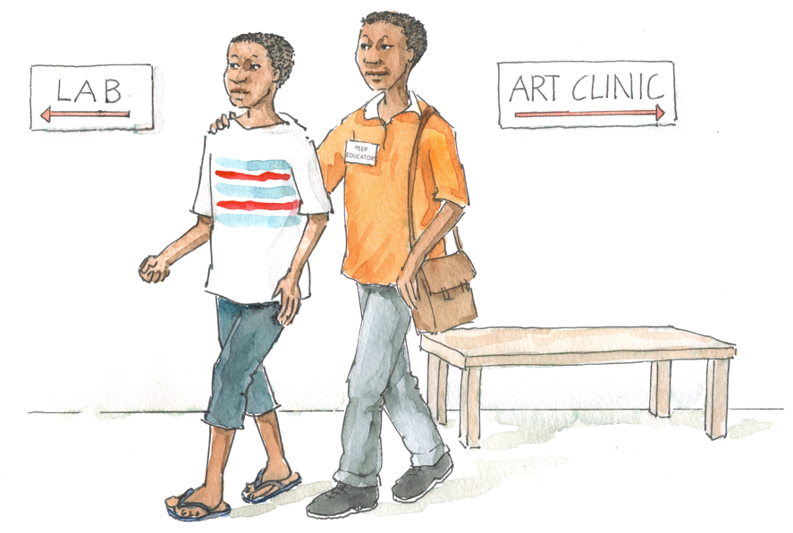
Discussion Questions
Thinking about your health facility:
Which of the areas discussed are lacking at your facility?
How could these areas be improved to better support ALHIV’s retention in care at your facility?
What are some of the challenges of implementing these actions? What are some of the solutions?

Slide 28
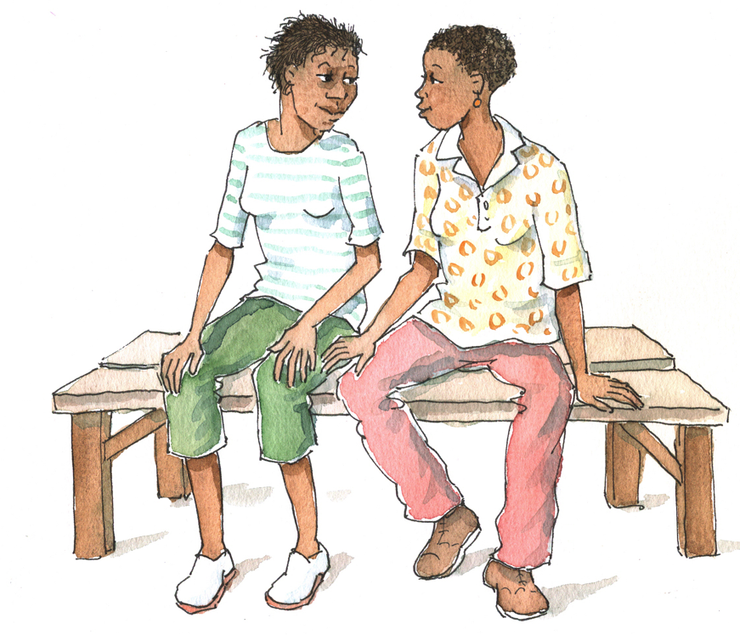
Remember:
One of the most important steps to improve retention in care is to ensure that services are youth-friendly.
Services that are youth-friendly increase the likelihood of client retention and also support perfect or near-perfect adherence to treatment.

Slide 29
Questions or comments on this session?

Slide 30
Session 8.3
Providing Adherence Preparation Support to ALHIV and Caregivers

Slide 31
Session 8.3 Objectives
After completing this session, participants will be able to:
Conduct adherence preparation sessions with ALHIV and their caregivers
Use tools to provide adherence counseling and to help clients and caregivers make a personal adherence plan

Slide 32
Pair Work: The Importance of Adherence Preparation
Discuss in pairs:
What happens at your clinic now to prepare adolescent clients and caregivers to start ART?
What do you think works well? What are some of the challenges?
What are some considerations for younger adolescents in terms of adherence readiness and preparation?
What is a treatment buddy and how might a treatment buddy help an adolescent client?

Slide 33
Overview of Adolescent-Friendly ART Adherence Preparation
Depending on the program and national guidelines, adherence preparation may include 1-4 group or individual sessions that take place over a number of days or weeks
Follow national guidelines and remember that ongoing adherence assessment and support is necessary
Group sessions are useful for giving many people information at one time
Individual sessions can be used to find out what the client learned from previously attended group sessions, to identify support needs, and to develop an individual adherence plan

Slide 34
Overview of Adolescent-Friendly ART Adherence Preparation (Continued)
ALL ALHIV should be given time — AT LEAST one session — to speak to a counselor, health worker, and/or Adolescent Peer Educator in private
Discuss potential adherence challenges and make an individual adherence plan
Remember:
Ideally, adherence preparation counseling should begin early in HIV care.
While providing as much support as possible, the team should be flexible when addressing ART readiness.
The preparation process should always facilitate ART initiation and should never act as a barrier.

Slide 35
What is a Treatment Buddy?
Someone chosen by a client to provide him or her with ongoing support for adherence to care and treatment
Usually a client’s caregiver, friend, family member, or another ALHIV who is also enrolled in care and who is a trusted person to whom a client can disclose his or her status
HCWs should explain the importance of having a treatment buddy to ALHIV and should make sure treatment buddies have the needed information and skills.
HCWs should encourage treatment buddies to accompany ALHIV on clinic visits.
Remember: not having a treatment buddy should not act as a barrier to any client initiating ART!

Slide 36
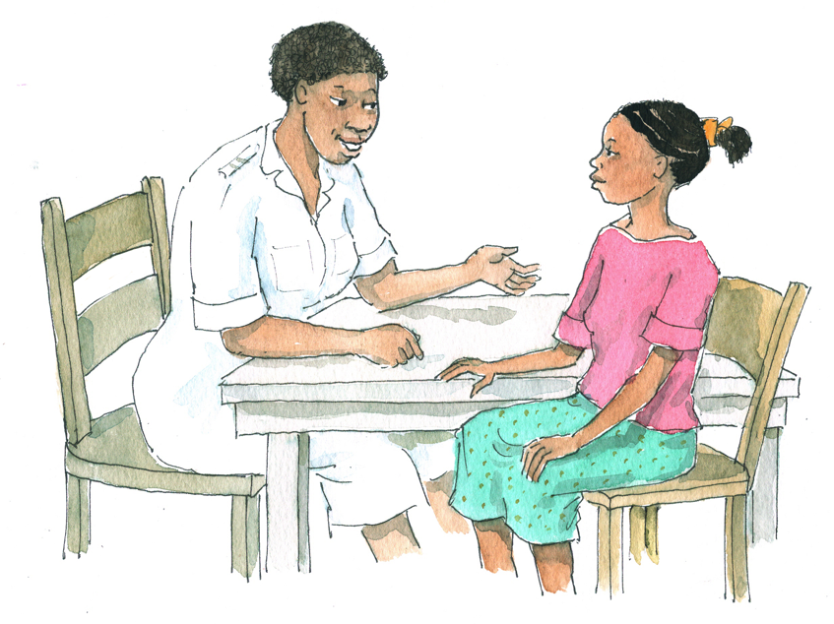
Adherence Preparation Topics
Review national adherence preparation guidelines and tools
Please take a marker and brainstorm answers on the “Adherence Preparation Topics” flip chart:
What are the most important adherence preparation topics to cover with ALHIV and their caregivers?

Slide 37
Key Topics for Adherence Preparation Education and Counseling
See Table 8.1.
Remember: It may be helpful to develop an adherence preparation checklist to ensure that adherence preparation sessions are consistent and cover all of the necessary information, no matter who is leading the session.

Slide 38
Helping Clients Develop a Personal Adherence Plan
The plan should address:
ARE YOU PLANNING TO TAKE YOUR MEDICINES? If the response is no, consider delaying ART initiation.
WHO will help you remember to take your medicine every day at the same time and to come to the clinic for appointments?
WHAT medicines are you taking? What is the dose of each and how often will you take it? What will you do when you are about to run out of your medicines? What will you do if you miss a dose of your medicine?
WHEN will you take your medicines? (Establish a routine.)
WHERE will you take your ART? Where will you store your ART?
HOW will you remember to take your medicines at the same time, every day? How will you know that you have taken your doses so that you don’t miss any or take them twice?

Slide 39
The Adherence Support Tree
See Appendix 8A: Adherence Support Tree.
This is a tool health workers can use to help clients and caregivers prepare for adherence to ART. It can also be used to ask about adherence at follow-up visits.
Let’s practice using the Adherence Support Tree:
Work in pairs – one person should play the role of the health worker and the other an adolescent client
Use the Adherence Support Tree to discuss the WHO, WHAT, WHEN, WHERE, and HOW of the medications (take about 5 minutes)
Next, switch roles and role play again

Slide 40
Debriefing Discussion
What do you think of the Adherence Support Tree?
How could the Adherence Support Tree be used in your clinic setting?

Slide 41
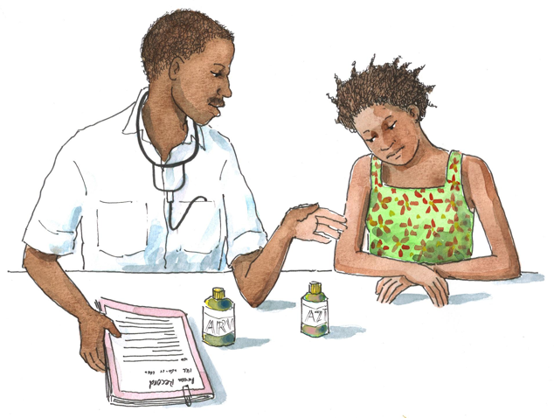
Discussion Question
What system do you currently use to assess a clients’ readiness to begin ART?

Slide 42
Assessing Clients’ and Caregivers’ Readiness for ART
See Appendix 8B: Adherence Preparation and Support Guides.
You can use the plan agreed upon during the WHO, WHAT, WHEN, WHERE, and HOW discussions when completing these guides with clients and caregivers
Standardized readiness assessment tools can:
Help health workers assess a client’s and caregiver’s readiness
Help clients understand the importance of lifelong adherence
Ensure a shared understanding of the client’s care and medications plan
Identify potential adherence challenges and help to brainstorm practical solutions

Slide 43
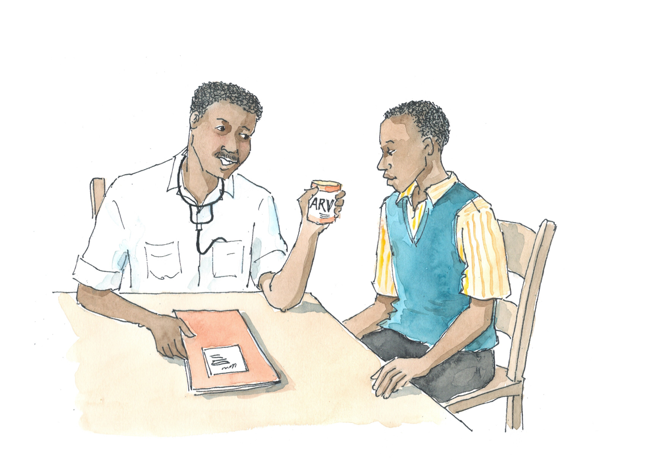
Assessing Clients’ and Caregivers’ Readiness for ART (Continued)
It may take 1, 2, or even more individual counseling sessions before a client is ready to start ART.
Remember: Assessment questions should be used to identify areas where the client may need additional support. It should not be used as a “test” that the client needs to pass before starting ART.

Slide 44
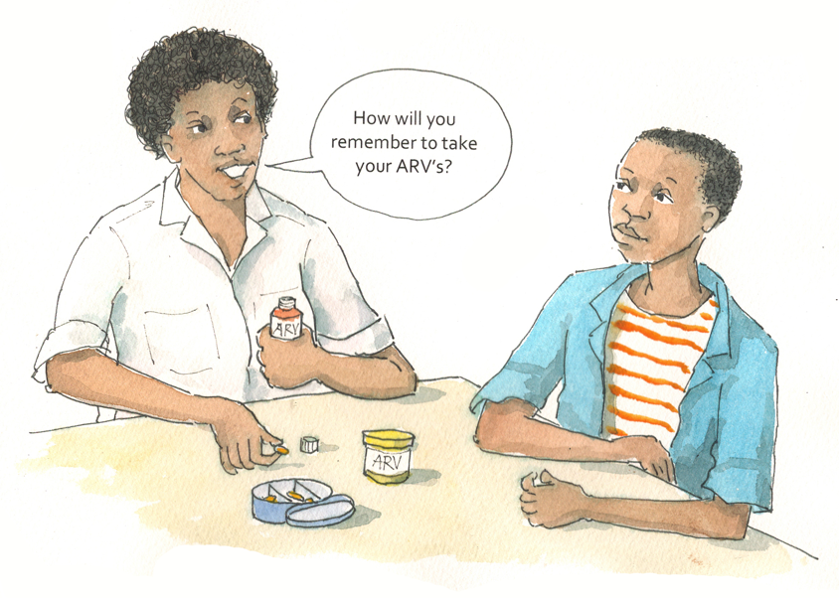
Discussion Questions
How could this assessment be modified for adolescents of different ages?
How do you think you could use these tools in your work/clinic?

Slide 45
Exercise 1
Developing an Adherence Plan: Trainer demonstration, case studies in small groups, and large group discussion

Slide 46
Exercise 1: Trainer Demonstration and Role Play - Case Study 1
B___ is 11 years old and is supposed to start taking ART today. B___ and her auntie have already gone through the group education sessions and today is B___’s adherence preparation visit. B___’s auntie is her primary caregiver and will be responsible for giving B___ her medicines every day. B___ understands that she has HIV and that she needs to take medicines every day, but her auntie is still worried how she will manage.
→ How would you help B___ and her auntie prepare today for adherence?
→ What questions would you ask to assess their understanding of adherence and B___’s readiness to start ART?

Slide 47
Exercise 1: Small Group Work – Case Study 2
S___ is 17 years old and lives by himself. He needs to start taking ART and, now that he has attended the group adherence preparation sessions, the doctor asks you to counsel him individually to further prepare him for ART adherence. S___ works during the day as a taxi assistant and you sense that it might be challenging for him to take his medicines the right way since he has not disclosed to anyone and works long hours.
→ How do you help S___ prepare to start taking ART?
→ What questions would you ask to assess S___’s readiness for ART?

Slide 48
Exercise 1: Small Group Work – Case Study 3
L___ is 17 years old and lives with her mother and father. She is going to start taking ART and, now that she has attended the group adherence preparation sessions, you have been asked to help prepare her and make an adherence plan. L___ is at the clinic with her older cousin and says that she does not talk much with her mother and father about HIV. Instead, her cousin has agreed to be her treatment supporter.
→ How would you prepare L___ and her cousin for good adherence?
→ What questions would you ask to assess their readiness and understanding?

Slide 49
Exercise 1: Small Group Work – Case Study 4
J___ is 14 years old and, based on her CD4 results, she is eligible to start ART. She has come to the clinic today with her father for adherence preparation and ART initiation (she has already attended group preparation sessions). Her mother passed away recently, so her father will be her main treatment supporter. While conducting adherence preparation counseling with J___ and her father, her father expresses some concern that ART might be bad for children. He goes onto say that his daughter feels fine without medicine, adding that he works long hours so J___ spends a lot of time at home with her older brother.
→ How would you proceed in preparing J___ and her father?

Slide 50
Exercise 1: Small Group Work – Case Study 5
N___ is 16 years old and lives with his mother and 4 younger siblings. N___ is still in school, but only because his mother makes him to go. N___ would prefer to spend his time with his friends, which he does as soon as school ends. He is rarely home before 21.00hrs and he is failing nearly half of his classes. He has not told his mother or siblings about his HIV-status, but he has told his best friend and partner, A___. A___ is 17 and she also has HIV.
→ How do you help N___ prepare to start taking ART (he has already attended group adherence preparation sessions)?
→ What questions would you ask to assess his readiness for ART?

Slide 51
Exercise 1: Large Group Discussion Questions
How did you decide on an adherence plan with the client or caregiver? What tools did you use? How would you measure the plan’s success or outcome?
Did you have any concerns about the client initiating ART? How would you address these concerns with the client and/or caregiver?
What advice did you give to the client about adherence to care and medicines? The caregiver?

Slide 52
Exercise 1: Debriefing
What did we learn?
Key points:
One of our most important tasks is to provide adherence preparation counseling and support to clients and caregivers.
Group sessions are helpful, but individual sessions are required to make an individual adherence plan.
Address the ARE YOU COMMITTED, and the WHO, WHAT, WHEN, WHERE, and HOW of the medicines with clients and caregivers. Using the Adherence Support Tree in Appendix 8A can help.
Using standardized assessment tools (Appendix 8B) can help determine a client’s and caregiver’s readiness for ART and where more counseling and support are needed.

Slide 53
Questions or comments on this session?

Slide 54
Session 8.4
Assessing Adherence and Providing Ongoing Adherence Support

Slide 55
Session 8.4 Objectives
After completing this session, participants will be able to:
Assess adolescent clients’ (and caregivers’) adherence
Provide ongoing, age-appropriate support to improve adolescent clients’ (and caregivers’) adherence

Slide 56
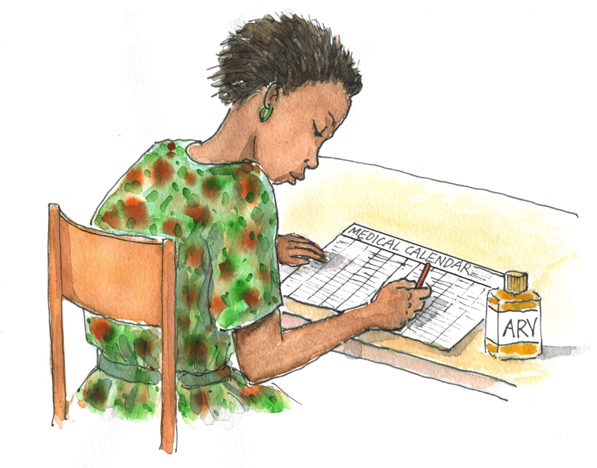
Discussion Questions
How do you currently assess adherence with clients at your clinic? With caregivers? What works well? What is challenging?
What questions would you ask clients and caregivers to assess adherence?
What other methods (for example, pill count) would you use to assess adherence?

Slide 57
Assessing Adherence
...is challenging, and there is no one perfect way to do it.
...requires ongoing, individual adherence assessment and counseling.
...can encourage clients to express challenges
Assess adherence at every visit!
All members of the MDT should ask questions about adherence.
If available, also ask the caregiver or treatment buddy about adherence.
Conduct separate sessions with older ALHIV and their caregivers.
Discuss differing answers with the client and caregiver together.
Do not judge!
Let clients know that everyone has problems taking medicines the right way all the time.

Slide 58
Assessing Adherence (Continued)
Build a trusting relationship and encourage clients to be completely honest.
Refer clients to peer support groups or link them to an APE.
Talk about clients’ adherence at MDT meetings.
Use tools to help assess and improve adherence, such as:
Pill counts
Review of clinical findings and lab tests
Review medicine diaries or calendars
For a client on ART, missing pharmacy refills or clinic appointments is a RED FLAG indicating poor adherence that should be addressed immediately.

Slide 59
Assessing Adherence (Continued)
See Appendix 8C: Adherence Assessment Guides.
1 guide for adolescent clients
1 guide for caregivers
Always follow national guidelines and use national tools (if they exist).

Slide 60
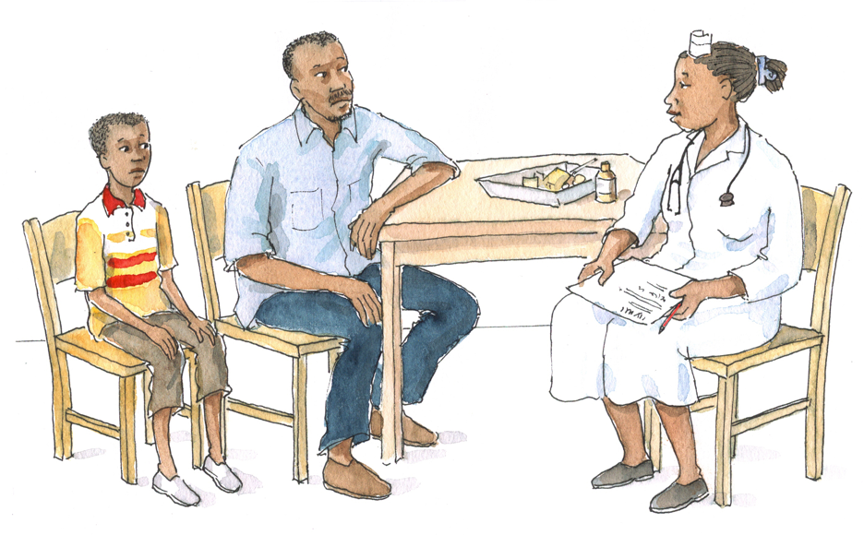
Discussion Questions
Why might it be important to ask adolescent clients and caregivers about adherence separately?
How could these assessments be modified for young versus older adolescents?
How do you think you could use these tools in your work/clinic?

Slide 61
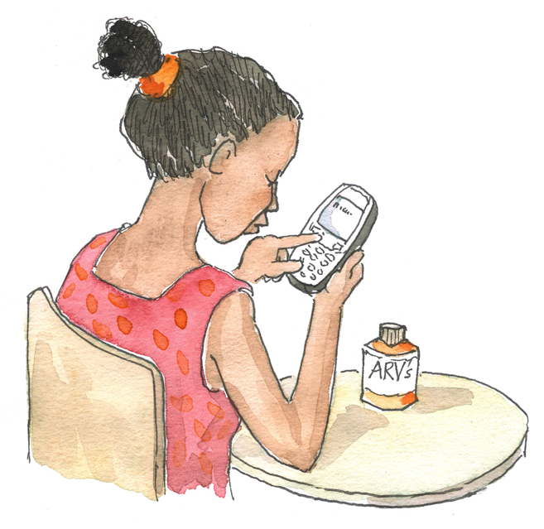
Discussion Questions
Why is it important to provide ongoing adherence support?
How do you think we can support long-term adherence to care among younger adolescents? Older adolescents? Caregivers?

Slide 62
Providing Ongoing Adherence Support
When providing adherence support, build on previously established trust and rapport, maintain a safe space to discuss any problems, and give ongoing encouragement.
If the client seems to be adhering well:
Praise the client (and the caregiver, if present) for good adherence.
Remind the client to come back if there are any problems.
Talk about how important it is to be open with health workers and to solve challenges together.

Slide 63
Providing Ongoing Adherence Support (Continued)
If the client seems to be experiencing challenges with adherence, provide individual counseling and:
Praise the client for sharing his or her challenges
Identify the client’s specific challenges
Help client resolve each challenge
Discuss importance of adherence
Refer client to an APE, adolescent support group, etc.
Refer difficult cases to a counselor or social worker
Plan for next steps
Record the session on the patient record
Follow up at the next visit
Share observations with the multidisciplinary team

Slide 64
Exercise 2
Assessing Adherence and Providing Support: Small group work, role play, and large group discussion

Slide 65
Exercise 2: Case Study 1
J___ and his uncle:
What are the client’s/caregiver’s main adherence challenges? What are some possible solutions?
What are some age-appropriate techniques a health worker could use to build the client’s/caregiver’s confidence and knowledge about adherence?
Are there any community-based services that might help the client? What suggestions or referrals would you make?
What did the health worker do to address differences between the 2 stories ( J___’s and his uncle’s)?

Slide 66
Exercise 2: Case Study 2
N___ and his mother:
What are the client’s/caregiver’s main adherence challenges? What are some possible solutions?
What are some age-appropriate techniques a health worker could use to build the client’s/caregiver’s confidence and knowledge about adherence?
Are there any community-based services that might help the client? What suggestions or referrals would you make?
Did the issue of disclosure come up during your counseling session with either N___ or his mother?

Slide 67
Exercise 2: Case Study 3
P___:
What are the client’s/caregiver’s main adherence challenges? What are some possible solutions?
What are some age-appropriate techniques a health worker could use to build the client’s/caregiver’s confidence and knowledge about adherence?
Are there any community-based services that might help the client? What suggestions or referrals would you make?
Did you include P___’s friend in any way? How could she be helpful?

Slide 68
Exercise 2: Case Study 4
M___ and her mother:
What are the client’s/caregiver’s main adherence challenges? What are some possible solutions?
What are some age-appropriate techniques a health worker could use to build the client’s/caregiver’s confidence and knowledge about adherence?
Are there any community-based services that might help the client? What suggestions or referrals would you make?
Do you think M___ was really taking 100% of her medicines?

Slide 69
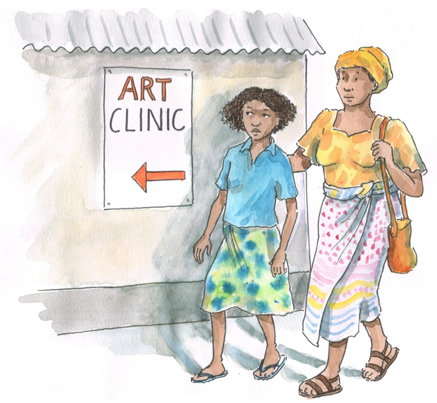
Exercise 2: Large Group Discussion Questions
What do you think will be the most challenging aspects of conducting adherence assessments with ALHIV and their caregivers at your clinic?
What approaches should health workers take to make clients and caregivers feel comfortable giving honest answers about adherence?

Slide 70
Exercise 2: Debriefing
What did we learn?
Key points:
An adolescent’s adherence needs change over time and as they age and develop; ask about adherence at every visit.
The Adherence Assessment Guides in Appendix 8C can be useful tools when asking clients and caregivers about adherence.
It is often helpful to ask clients and caregivers about adherence separately.
It is important to build a trusting relationship with adolescent clients so they feel comfortable being honest with us about adherence challenges.
It is important not to judge clients (or caregivers) if they are non-adherent!

Slide 71
Questions or comments on this session?

Slide 72
Module 8: Key Points
Retention and adherence are closely related and are key components of comprehensive adolescent HIV care and treatment.
Retention refers to keeping (or “retaining”) clients in the care program, which in this case means that clients continue accessing lifelong HIV care and treatment services.
Clients must take over 95% of their necessary ART doses to achieve the conditions for therapeutic success. Our aim is to support clients to achieve and sustain this rate of adherence to their regimens, both for their own health and to protect their sexual partners (“altruistic adherence”).
One of the most important steps to improve retention in care is to ensure that services are youth-friendly.

Slide 73
Module 8: Key Points (Continued)
ART preparation usually includes group education sessions, individual counseling sessions, and an adherence readiness assessment.
Ideally, adherence readiness assessment and counseling should begin early during HIV care, but they should not be a reason to delay initiation of ART.
Each client should have at least one individual adherence preparation counseling session with a health worker before starting ART. Caregivers and treatment buddies, when available, should also participate.

Slide 74
Module 8: Key Points (Continued)
Health workers can help the client develop a personal adherence plan by asking the are you committed? question and the who, what, when, where, and how of the medications. The Adherence Support Tree and Adherence Preparation and Support Guides can be helpful tools.
The best way is to assess adherence is to use several methods. HWs can use the Adherence Assessment Guides to ask clients and caregivers about adherence at each clinic visit.
Adherence support services should be ongoing and the entire MDT is responsible for providing these services.
Ongoing adherence support is especially important for adolescents because their adherence to care and medications will change over time.

